Slide 1
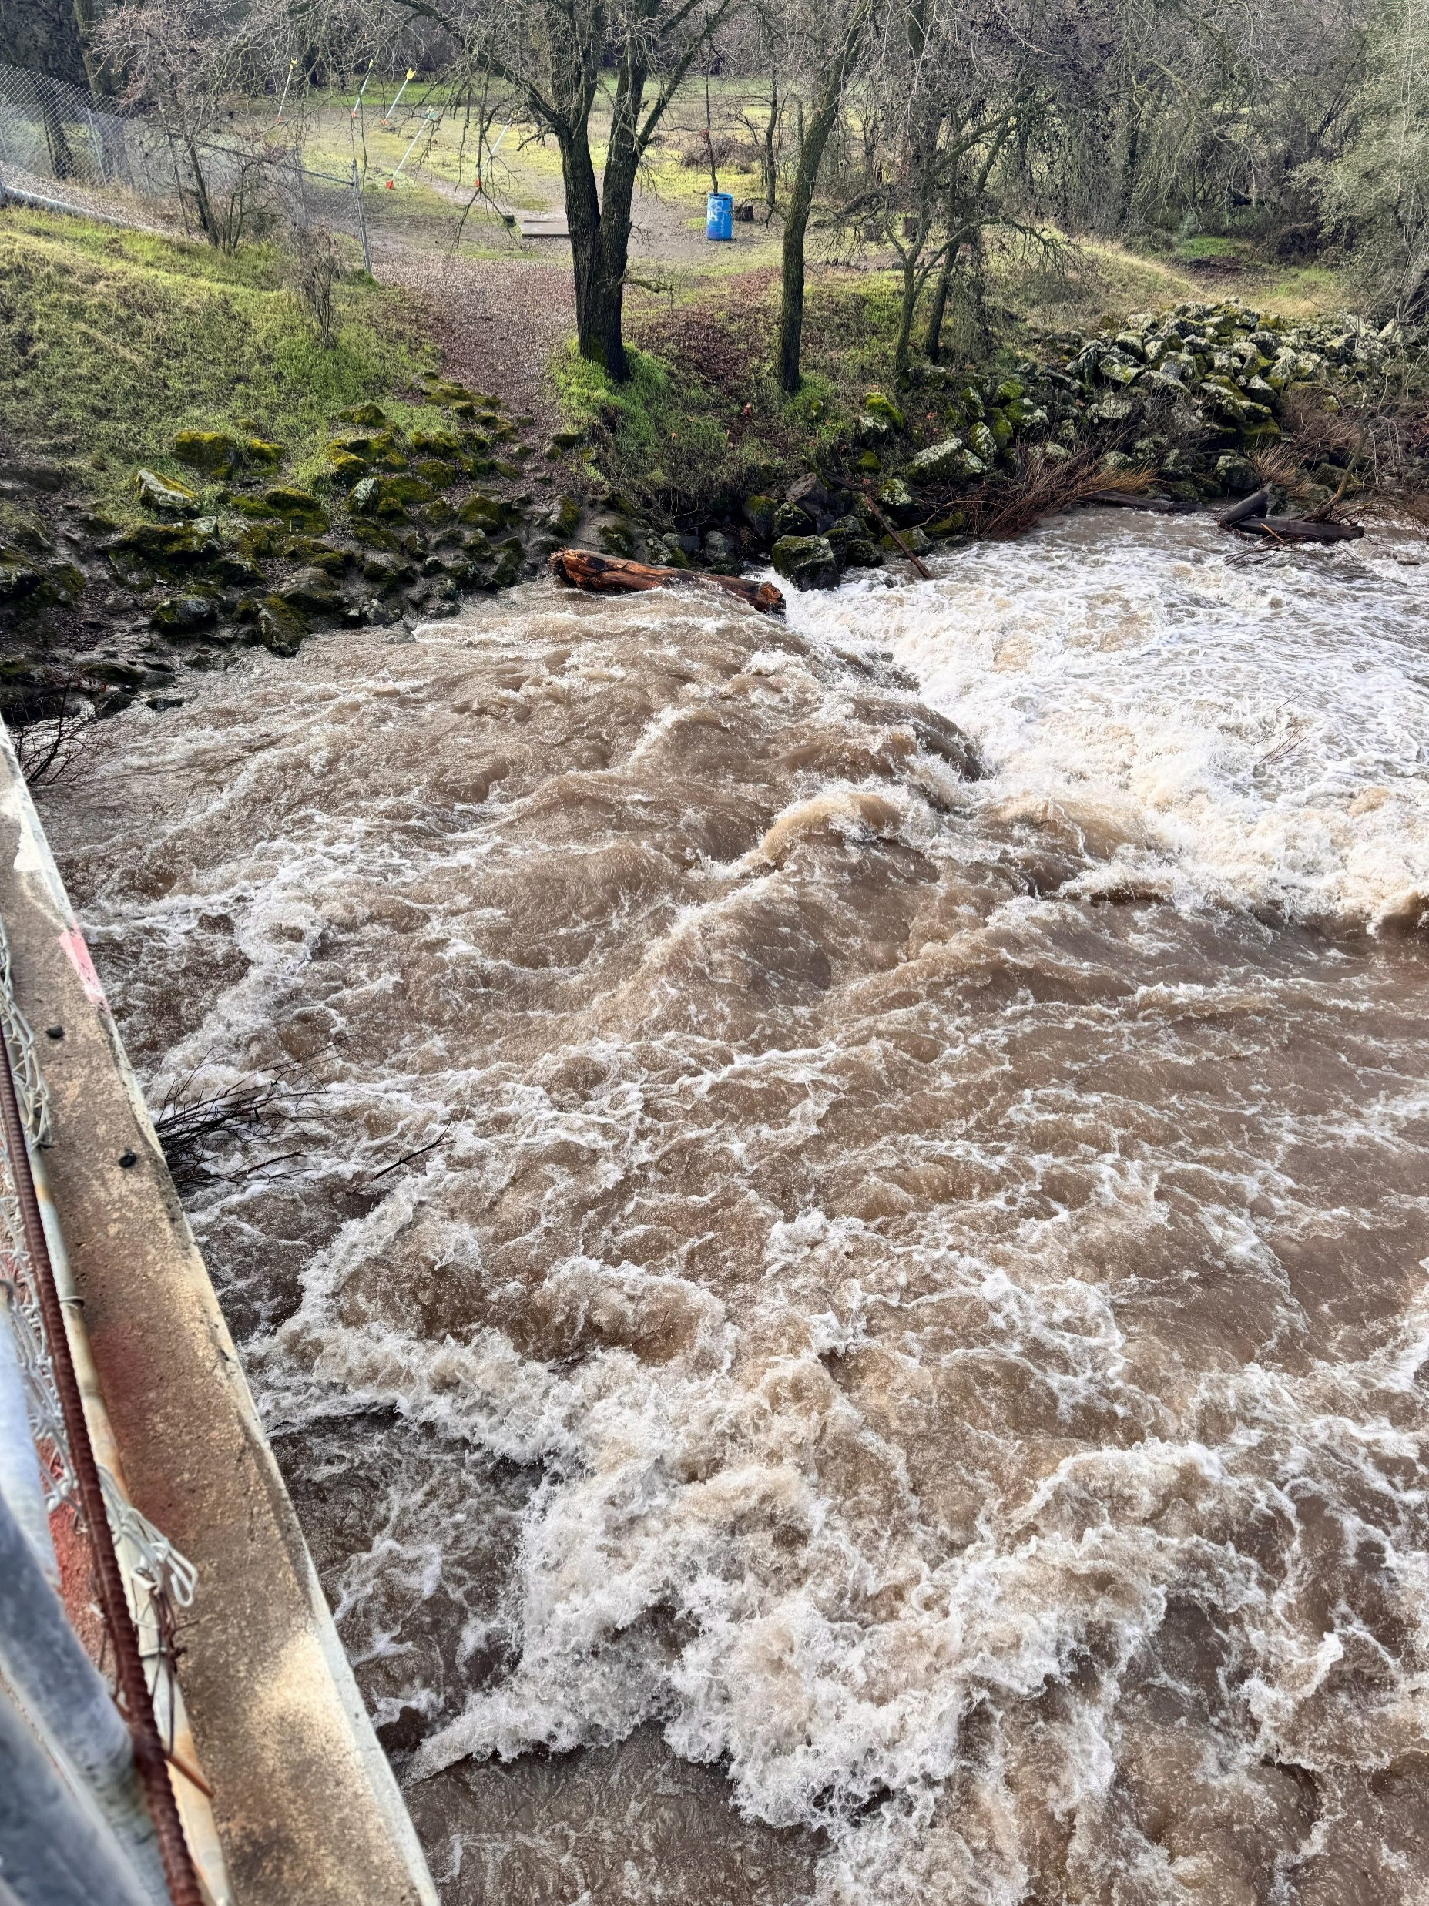
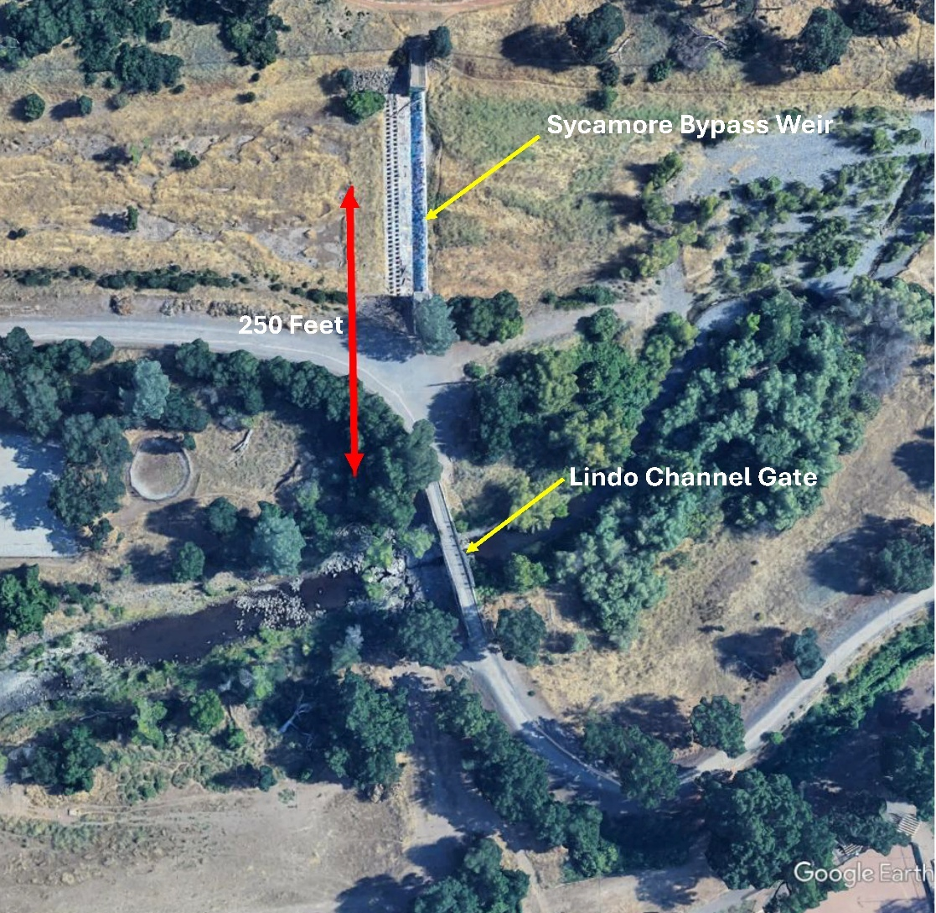
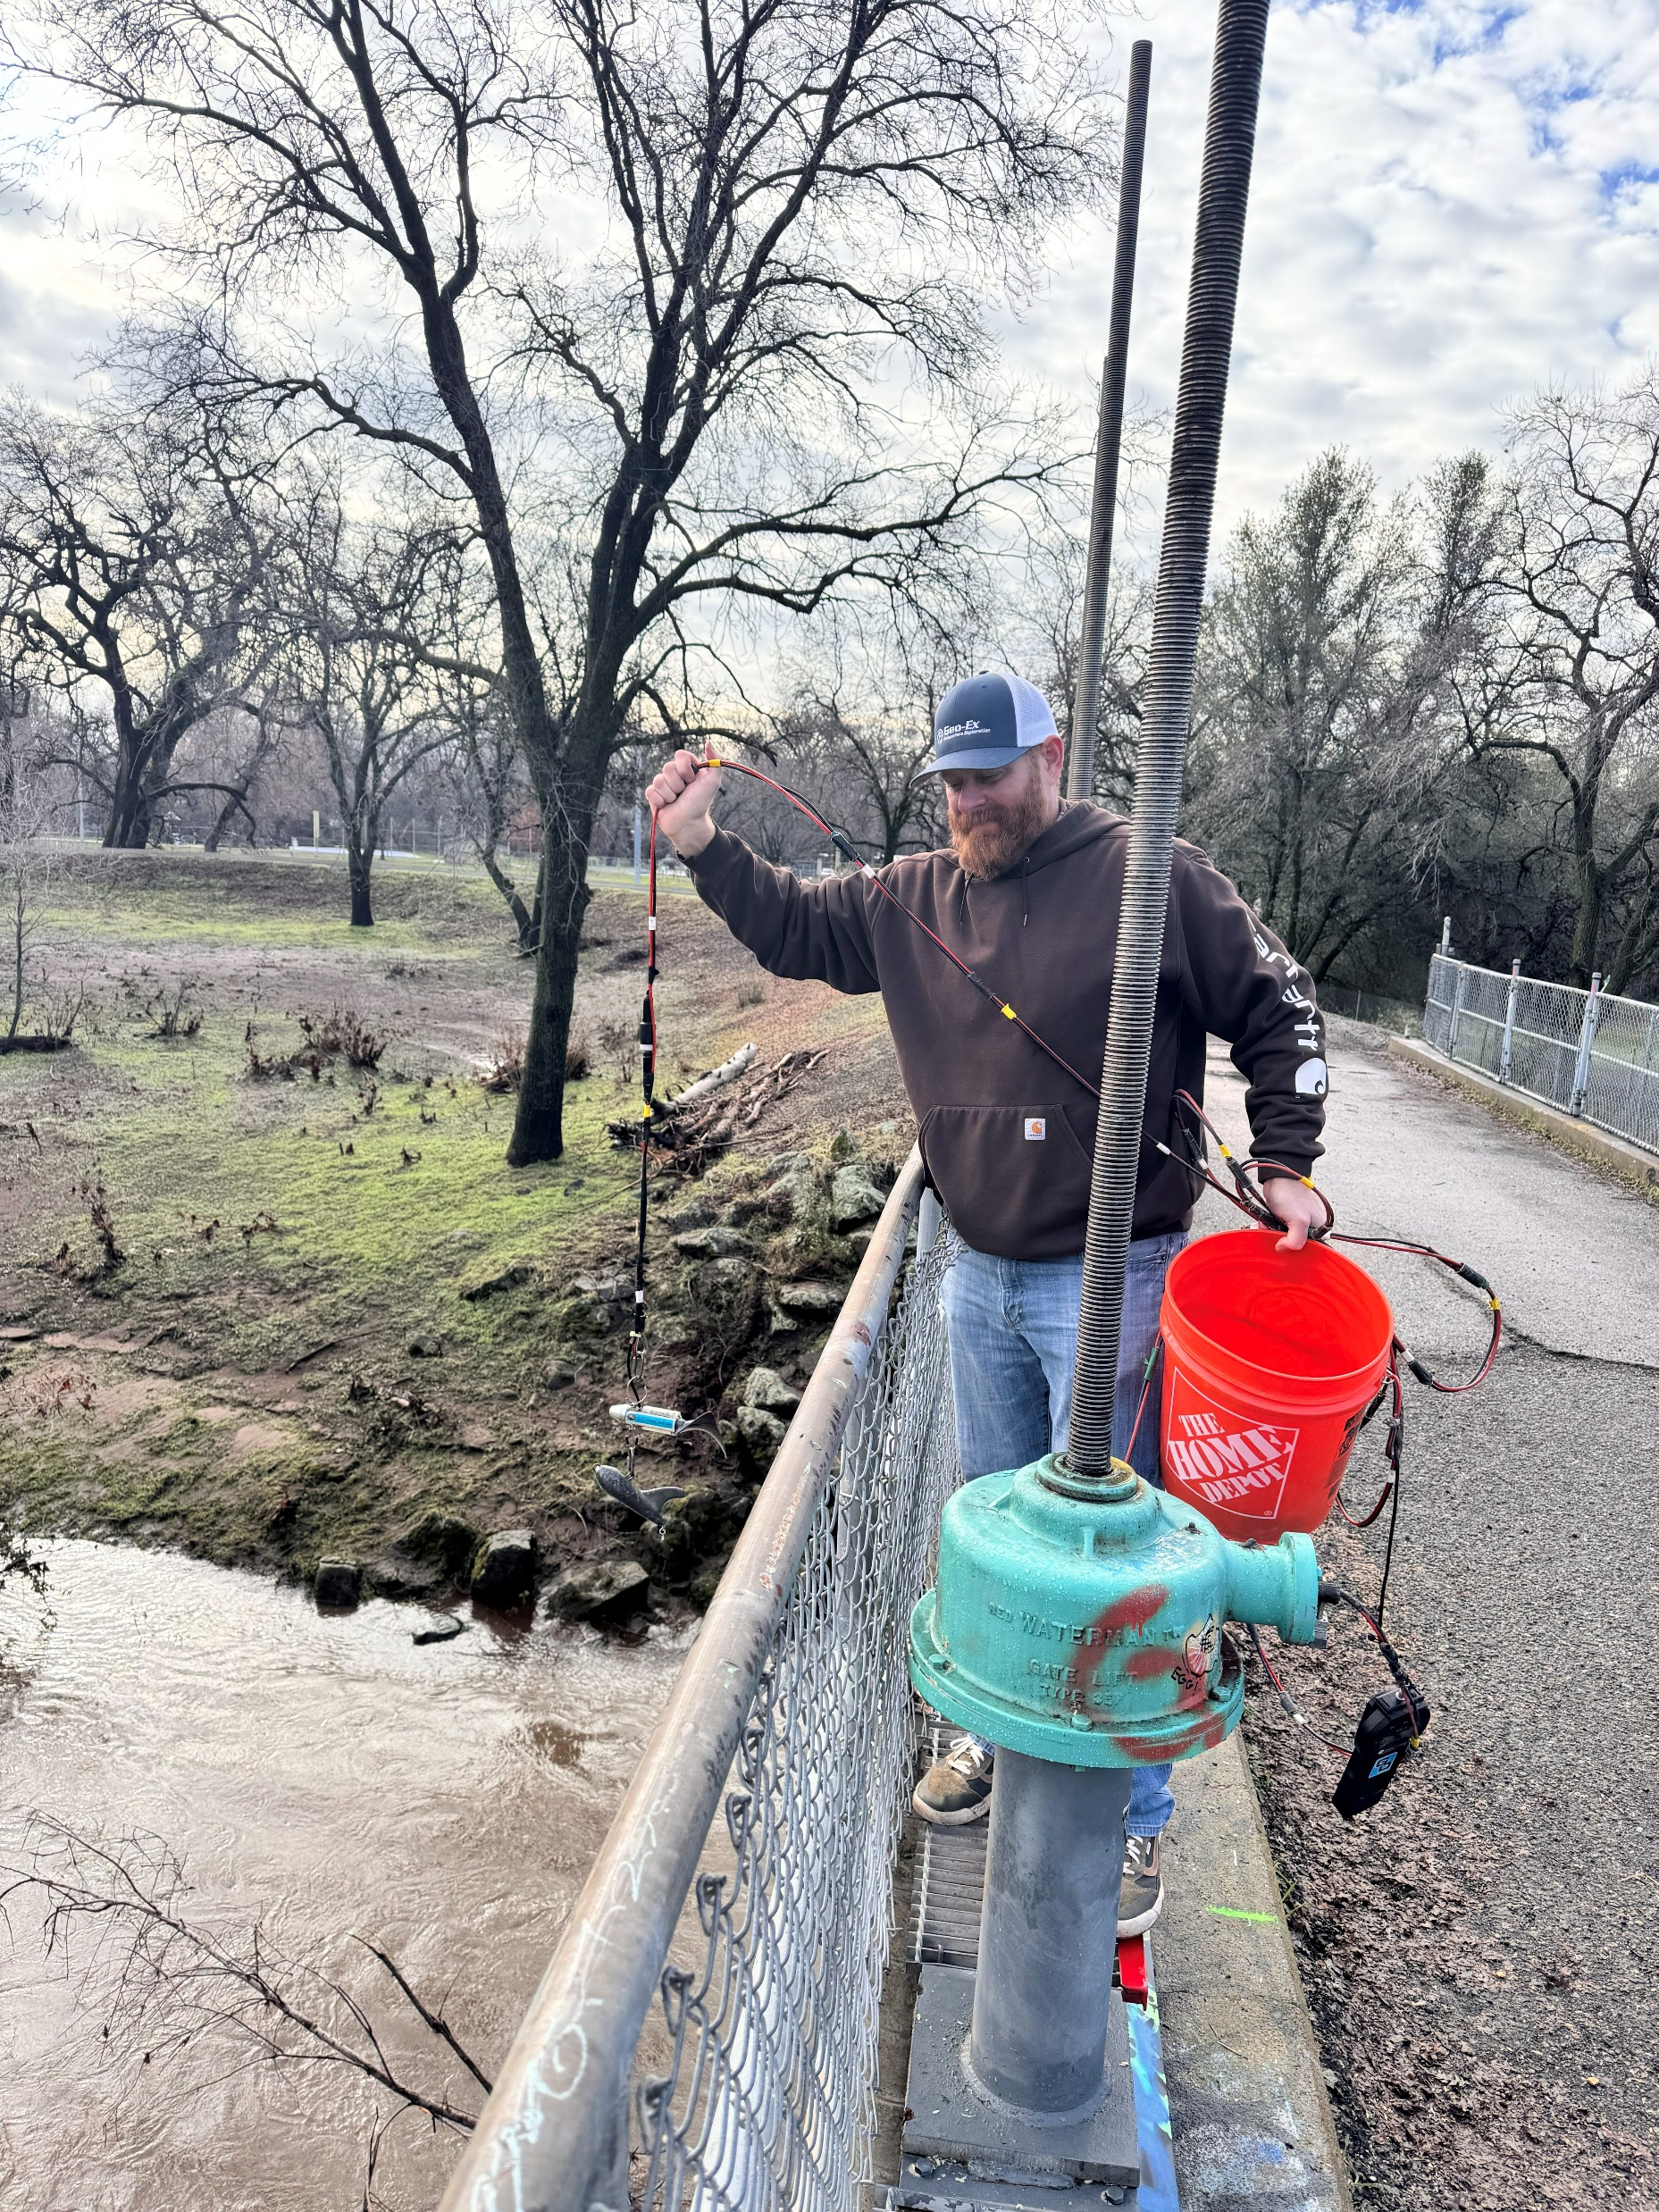
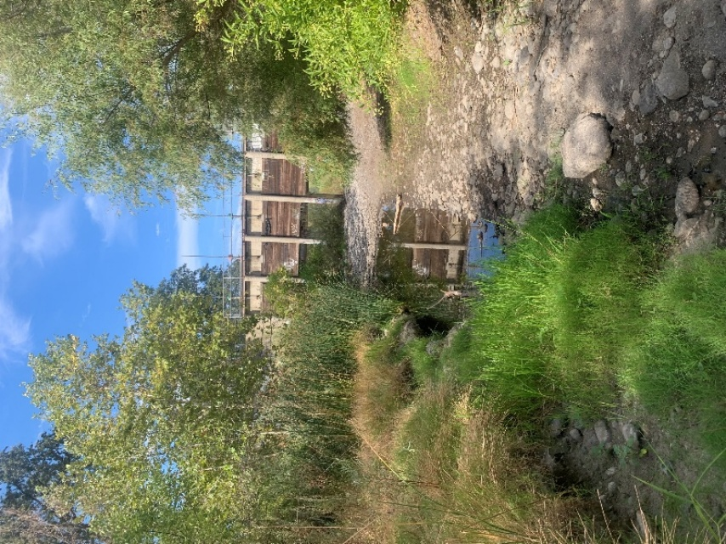
Lindo Channel Recharge Feasibility
Vina GSA Stakeholder Advisory Committee
Meeting - March 25, 2026

Slide 2
Agenda
Overview
Scope of Work
Physical Setting
Field Programs and What we Learned
Questions
Modeling
Takeaways
Next Steps
Questions

Slide 3
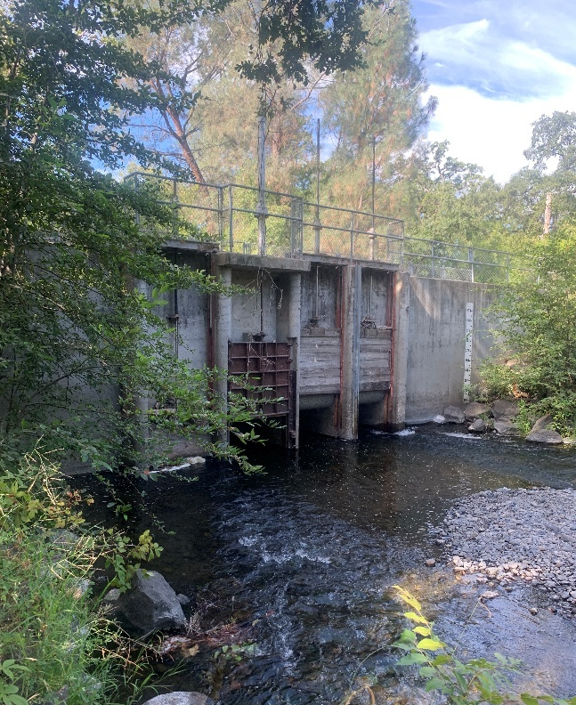
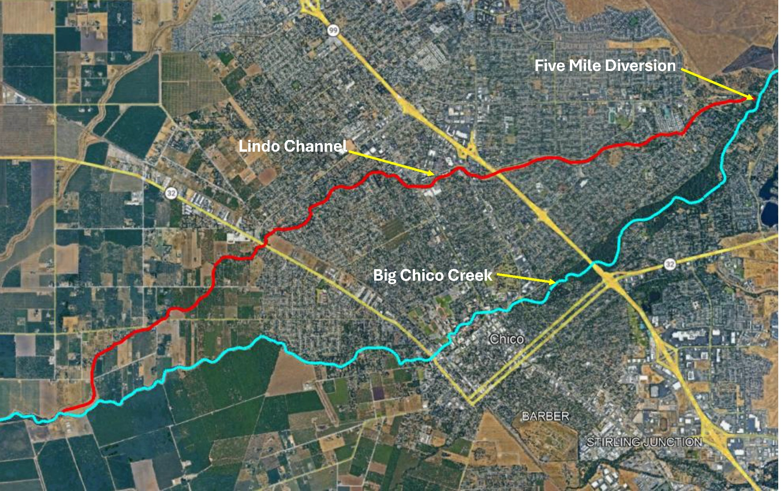
Lindo Channel Recharge Feasibility Overview
Component 4 of Vina GSA Implementation Grant
Working with City of Chico and State Agencies
Assessing Feasibility of Increasing Natural Recharge Along Lindo Channel
Notes:
Historically known as Sandy Gulch
8.5=mile seasonal flood channel
Functions as diverted branch of Big Chico Creek
Only receives water during winter months
Water diverted into channel from Big Chico Creek at Five Mile Diversion

Slide 4
Overview
Notes:
1965 USACE Lindo Channel Improvement
Consisted of Five Mile Gate System
Lindo Channel Gate
Weir at Head of Sycamore Bypass- Connects Lindo Channel and Sycamore Creek

Slide 5
Scope of Work
Develop Flow Thresholder
Water Rights, habitat, downstream beneficial users
Estimate Expected Recharge Yield
Evaluate Infrastructure or Stream Improvement Needs
Assess Percolation (Infiltration) Rates
Prepare Project Draft Implementation Plan
Assess Environmental and Regulatory Permitting Needs
Assess Operational requirements
Monitoring Program

Slide 6
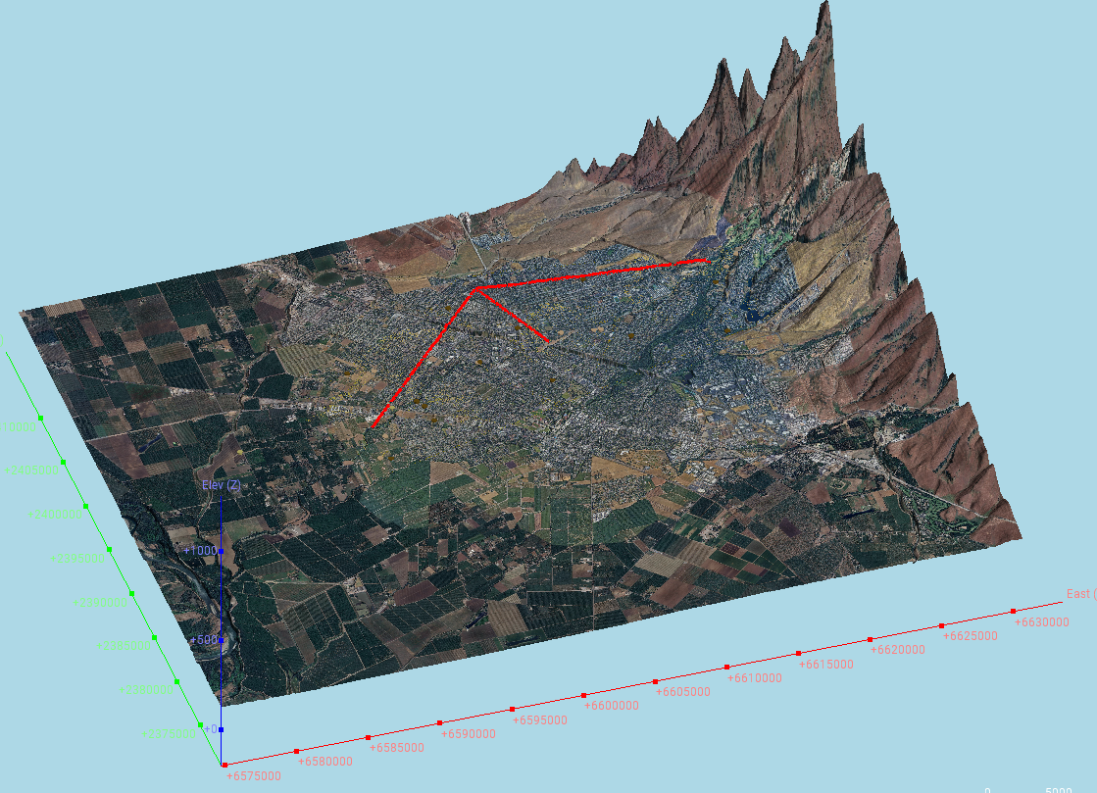
Physical Setting
Hydrogeology
Topography
Hydrology

Slide 7

Field Programs
Designed to Understand How Water Flows From Lindo Channel To Groundwater.
Infiltration Tests
Flow Rates
Continuous Water Levels
Water Quality Testing

Slide 8
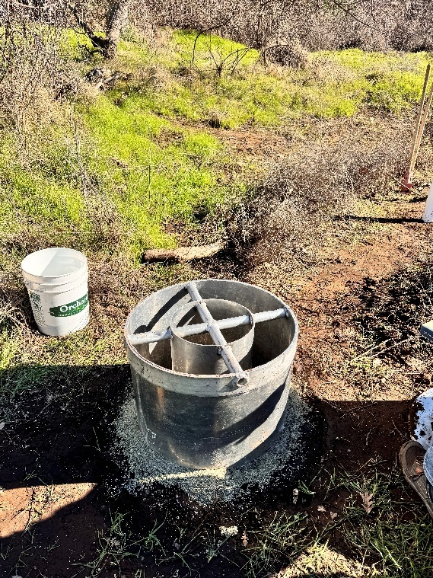
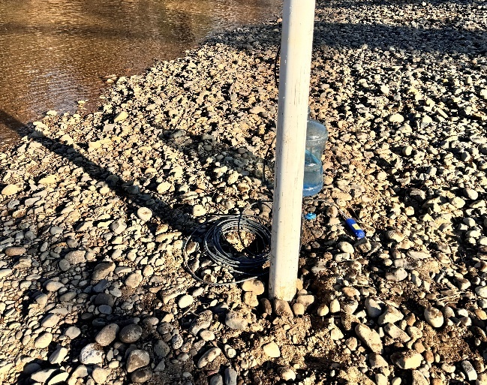
Infiltration Tests
Maximum – 491 Feet per Day
Minimum – 13 Feet per Day
Average – 262 Feet per Day
Model used 24 Feet per Day

Slide 9
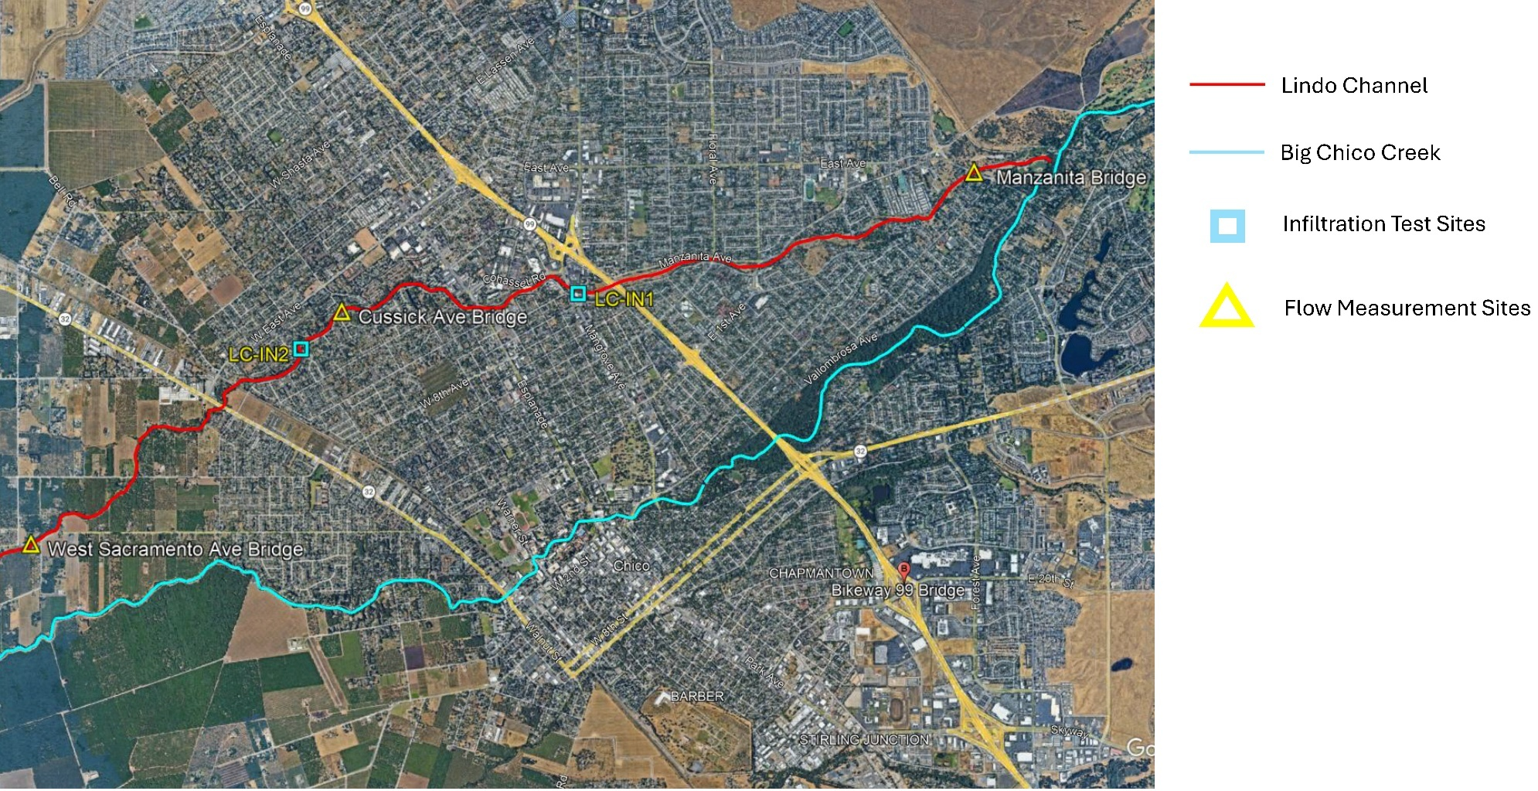

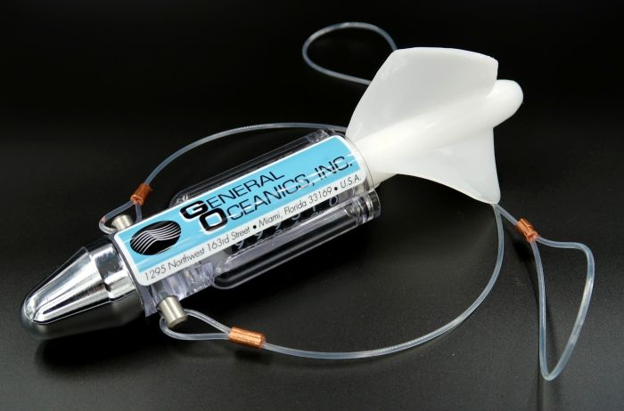
Flow Rates
Manzanita Avenue | Cussick Drive | West Sacramento
827 cfs | 667 cfs | 529 cfs
Questionable Data due to High Flow Rates and Debris
Does show decrease in flows going downstream
Confirms groundwater recharge
Calculated Groundwater Recharge > 100 AFD

Slide 10
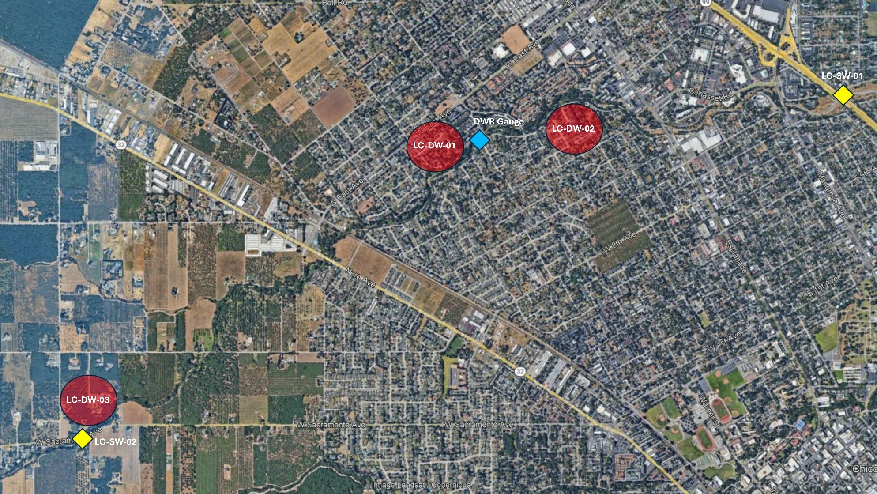
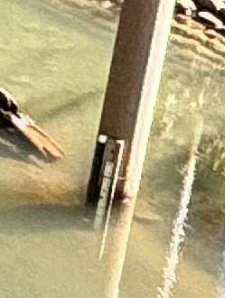
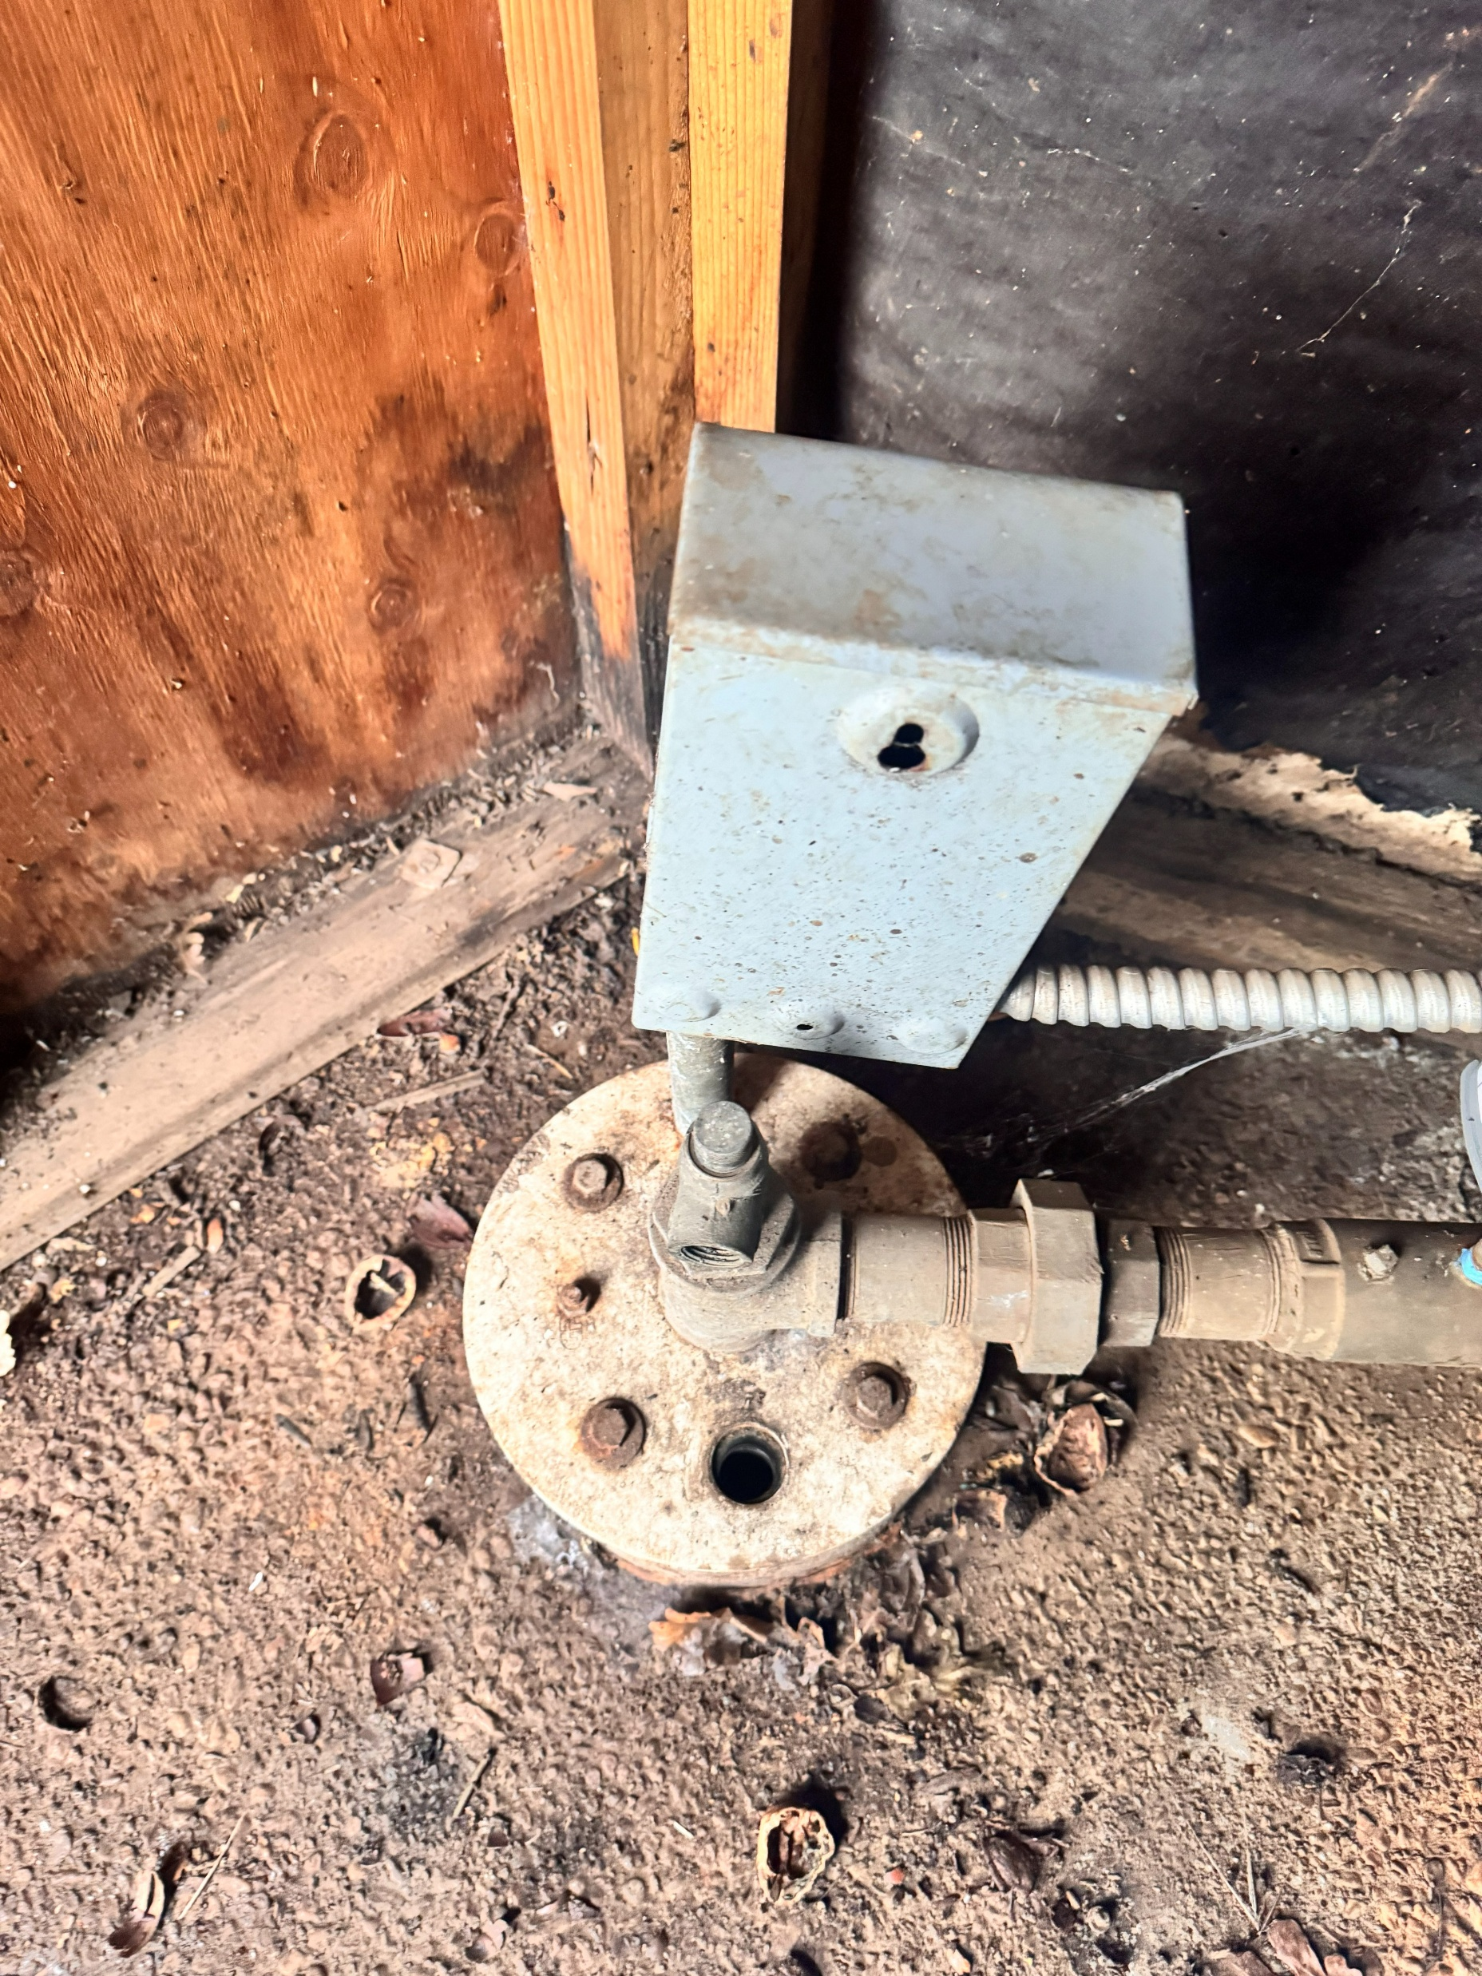
Continuous Water Levels
Domestic Wells
Interactions Between Lindo Channel Water and Groundwater
Stilling Wells

Slide 11
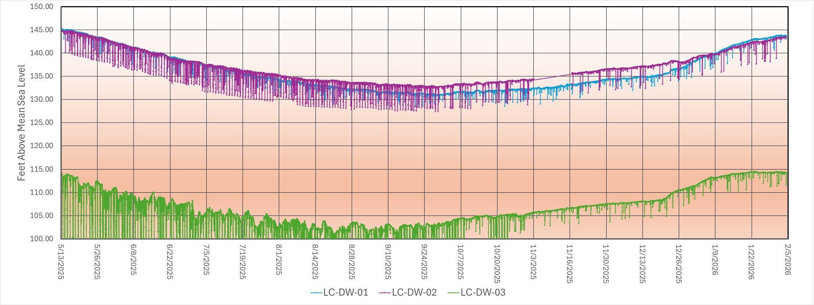
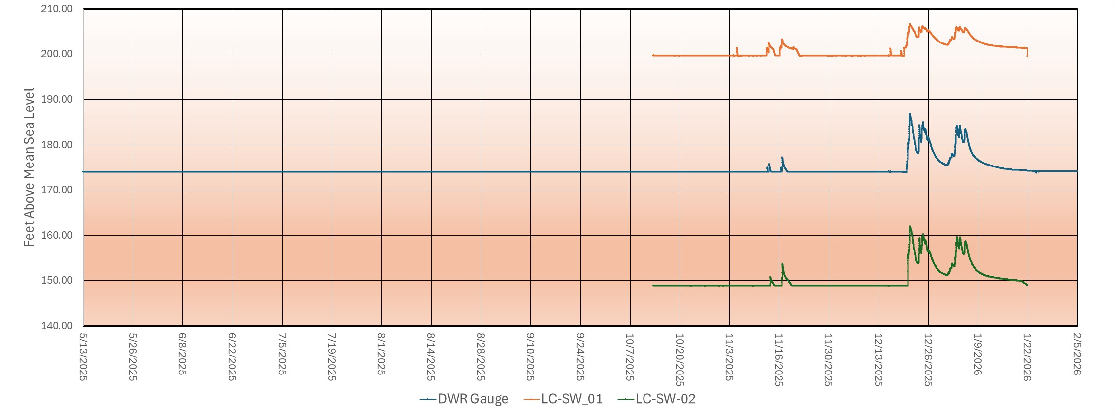
From May 2025 to September 2025 Water Levels Dropped 12 to 13 Feet
Water Levels Recovered to May 2025 Levels by February 2026
Water Levels in Domestic Wells Clearly Show Response to Water in Lindo Channel

Slide 12
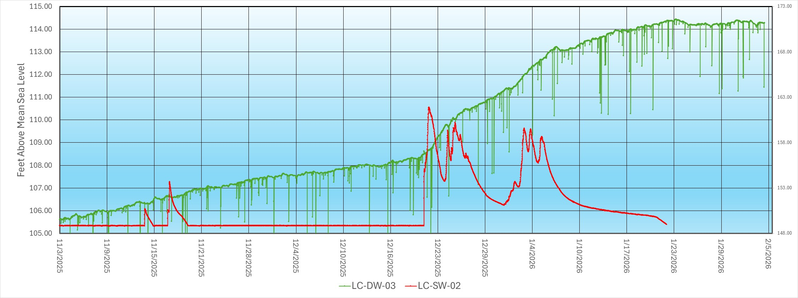
Hydrographs Definetly show groundwater is being recharged by water in Lindo Channel.
Using simple assumptions infiltration rates 4 to 62 feet/day
With same assumptions groundwater recharge when water flowing 31 to 992 acre-feet/day

Slide 13
Water Quality
Isotope data Supports Quick Infiltration of Lindo Channel Water in Shallow Groundwater
All wells Mg-HCO3 Water Type – Shallow Fresh Groundwater.
After Flow in Lindo Channel modest increase in HCO3 and slight reduction in SO4 – Consistent with recharge pulse
Slight NA+K increase – minor cation exchange – also supports recharge signal

Slide 14
Questions

Slide 15
FLOW MODELING

Slide 16
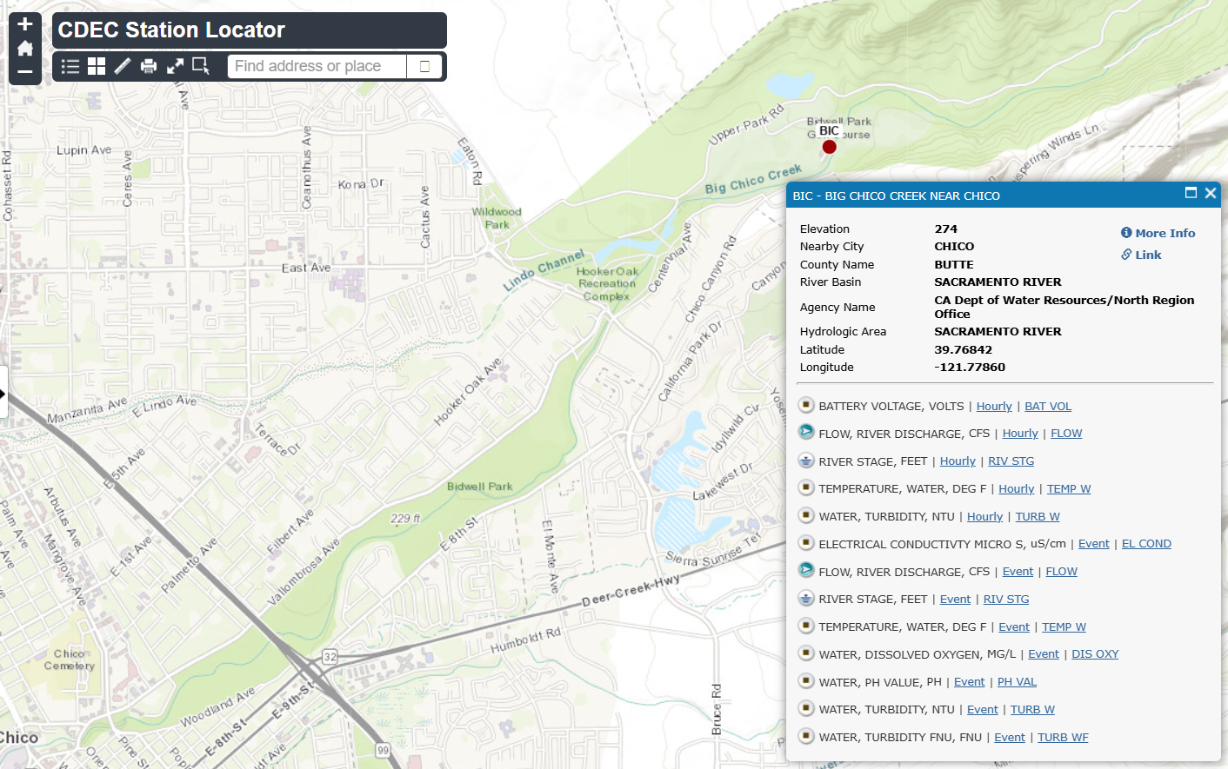
Approach
Ecological flows assessment (not described here)
Flood flow frequency analysis at BIC
Flow split two-dimensional numerical modeling at Big Chico/Lindo
Lindo Channel one-dimensional numerical modeling
Infiltration calculations
Concurrent hydrogeologic analysis
Source: CDEC

Slide 17
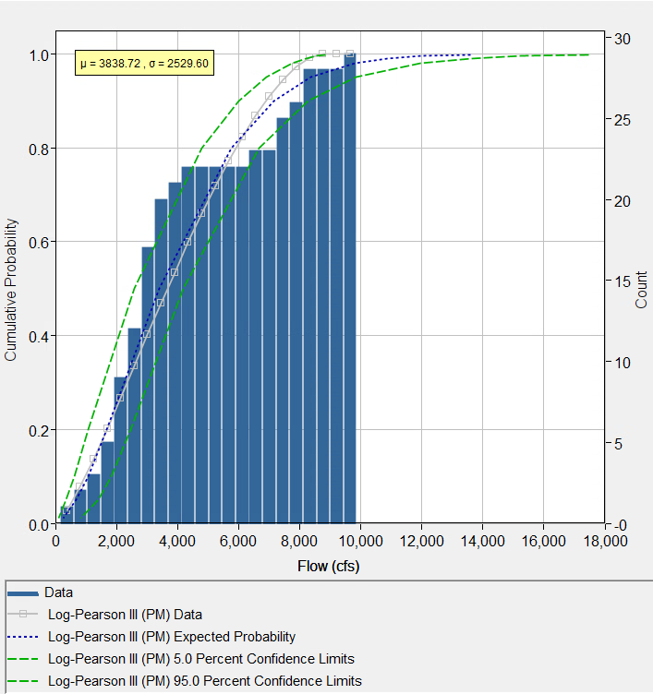
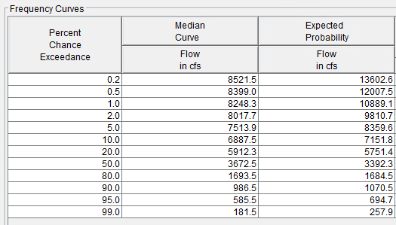
Flood flow frequency analysis
BIC gage
28 years of record (1997-present)
HEC-SSP (Bulletin 17C)
Discharges for 1-, 2-, 5- and 10-year return periods
Log-Pearson III distribution vs. Gumbel distribution
Representative historical runoff event selected for each return period event for numerical modeling

Slide 18
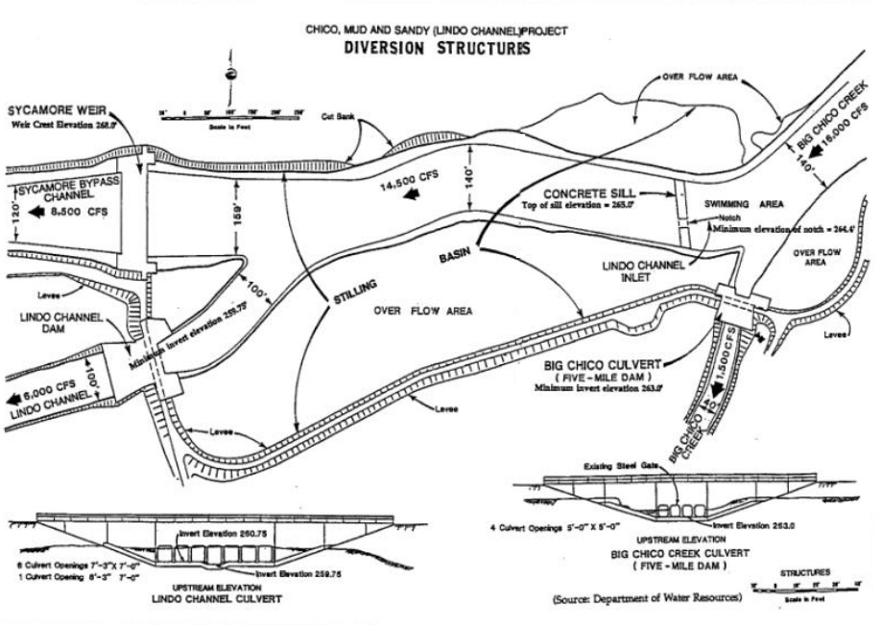
2D flow split modeling
HEC-RAS
Two terrains: existing and as-built
Hydrology from HEC-SSP
Goal – determine flow distribution between Big Chico (main channel), Lindo (distributary) and overflow channel (Sycamore Bypass).
Source: City of Chico

Slide 19
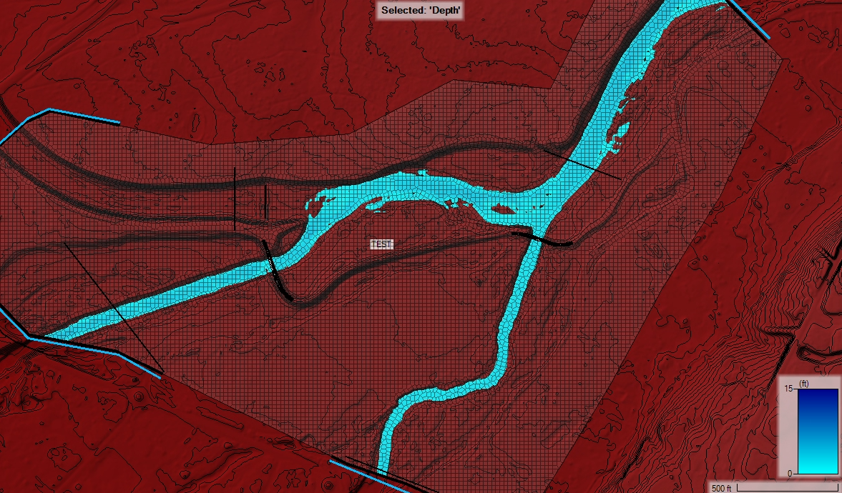
Lindo Channel 2D flow split model

Slide 20
Flow split model Hydrographs
63% of upstream hydrograph is distributed to Lindo Channel
66%
Existing Conditions
As-built Conditions

Slide 21
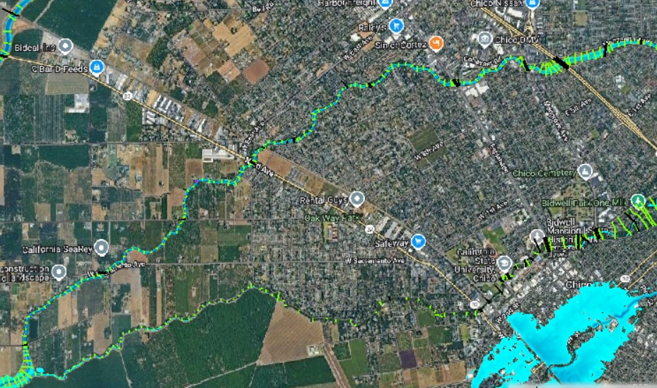
1D Lindo Channel modeling
1D HEC-RAS Model developed by others
1D modeling goal is to determine top width and wetted perimeter for each section along the channel between Highway 99 and the Big Chico confluence at each model time step
Area available for infiltration is:
A = RL* WP (or B)

Slide 22

Infiltration calculations
Python script written to organize results from HEC-RAS
Volume = A Δt IR
Assumptions: no saturated soils, constant infiltration rate in space, constant infiltration rate in time, sufficiently low groundwater table, no anisotropy
Did not use other methods (i.e., Green-Ampt) which require calibration
Calculations use 1 inch/hour

Slide 23
Results – 2-year, Existing Condition

Slide 24
Results – 2-year, as-built

Slide 25
Results – 2-year, existing vs. as-built
D=-0.067, 1867 ACFT
Existing Conditions
As-built Conditions

Slide 26
Takeways
Infiltration in-stream provides a valuable source of groundwater recharge
Modeling indicates in-stream diversions can substantially increase groundwater recharge when considering more frequent, lower discharge storm events
Modeling indicates that in-stream diversions of frequent events can infiltrate groundwater more efficiently than storage basins in some systems
Long infiltration times for small, frequent runoff events are more efficient for recharge design than scalping high volumes for large, less frequent runoff events**
Field Investigations and Monitoring support these findings

Slide 27
Alternatives and Next Steps
Modification to Sycamore Bypass to allow temporary increases
Grading in Lindo Channel to create ponding for low flows
Storm drain improvements that prevent water from leaving watershed
Identify opportunities to divert sheet flow to Lindo Channel
Install permanent monitoring system with telemetry
Engage in multi-agency coordination and long-term permitting.

