Slide 1


Demand Reduction Strategies
Extend Orchard Replacement (EOR) Pilot Study
Precision Irrigation (PI) Pilot Study
Vina GSA Board of Directors – March 11, 2026
Joel Kimmelshue, PhD, Land IQ

Slide 2
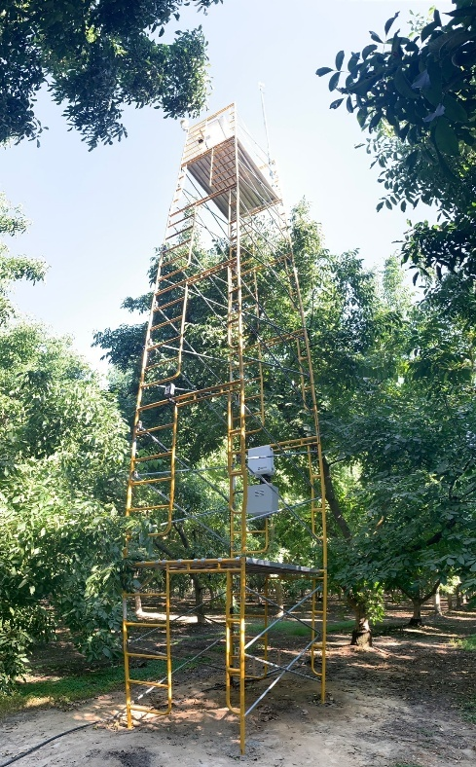
Cooperators
Land IQ
  Project Manager: Stephanie Tillman, MS
  Principal Scientist: Joel Kimmelshue, PhD
  Technical Advisors:
    Allan Fulton, MS – Retired Irrigation/Crop Production Specialist
    Tom Devol, BS – Retired Irrigation and Water Resources Specialist
Independent Technical Advisor
    Joe Connell, MS – Retired UCANR Farm Advisor
ERA Agricultural Economics
    Duncan MacEwan, PhD
    Tori Laird, BS
    Josh Virene, MS

Slide 3
Demand Reduction Strategies - Background
Grant funded through DWR
Conducted to show progress on GSP implementation actions
For the purpose of addressing estimated 10,000 ac-ft annual overdraft
Specifically, this is to address two main demand reduction strategies:
  Extend Orchard Replacement
  Precision Irrigation

Slide 4
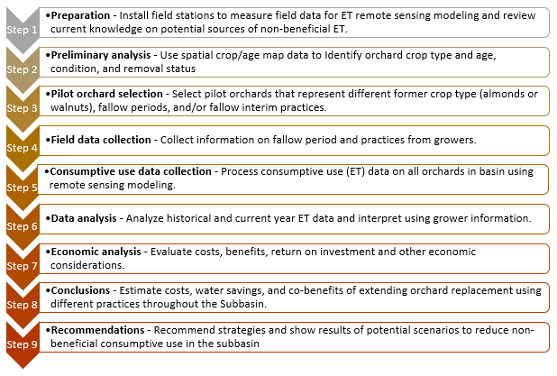
Project Approach
Both projects followed the same approach, except:
Extend Orchard Replacement Only

Slide 5
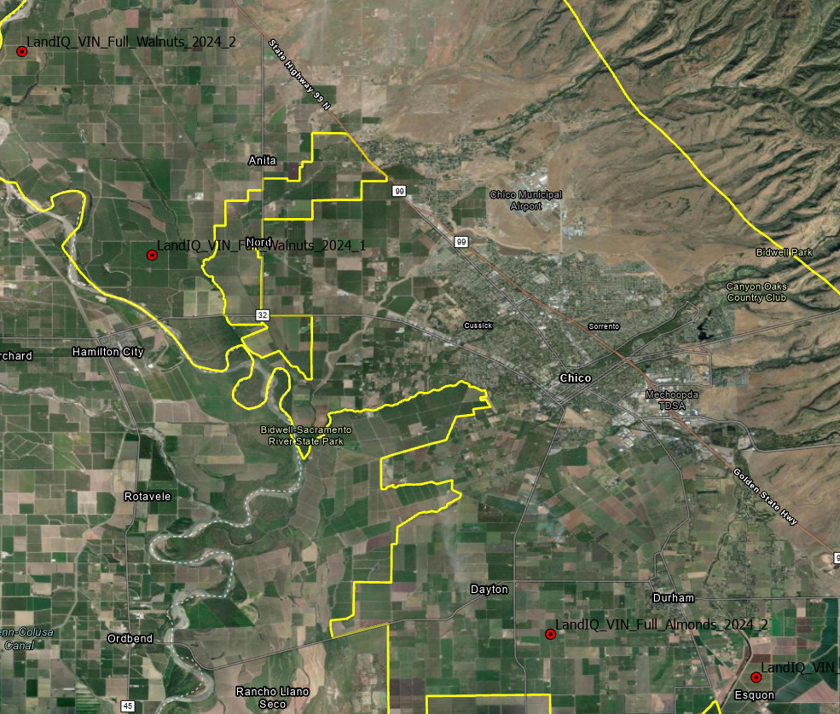
Spatial Data for Pilot Studies - ET
Evapotranspiration: Fundamental Measurement Approach
  Walnuts: 2 stations
    20-year old orchard in northwest
    9-year old orchard in west central
  Almonds: 2 stations
    15-year old orchard in southwest
    8-year old orchard in the southeast
  ET then modeled for every block in the subbasin from Jan-Oct
Other variables measured or observed:
  historical ET (2019-2024), precipitation, irrigation method and management, cultural practices, orchard condition, orchard size, soil type, crop rotations, removal status, root stock, spacing, variety, yield, etc.

Slide 6
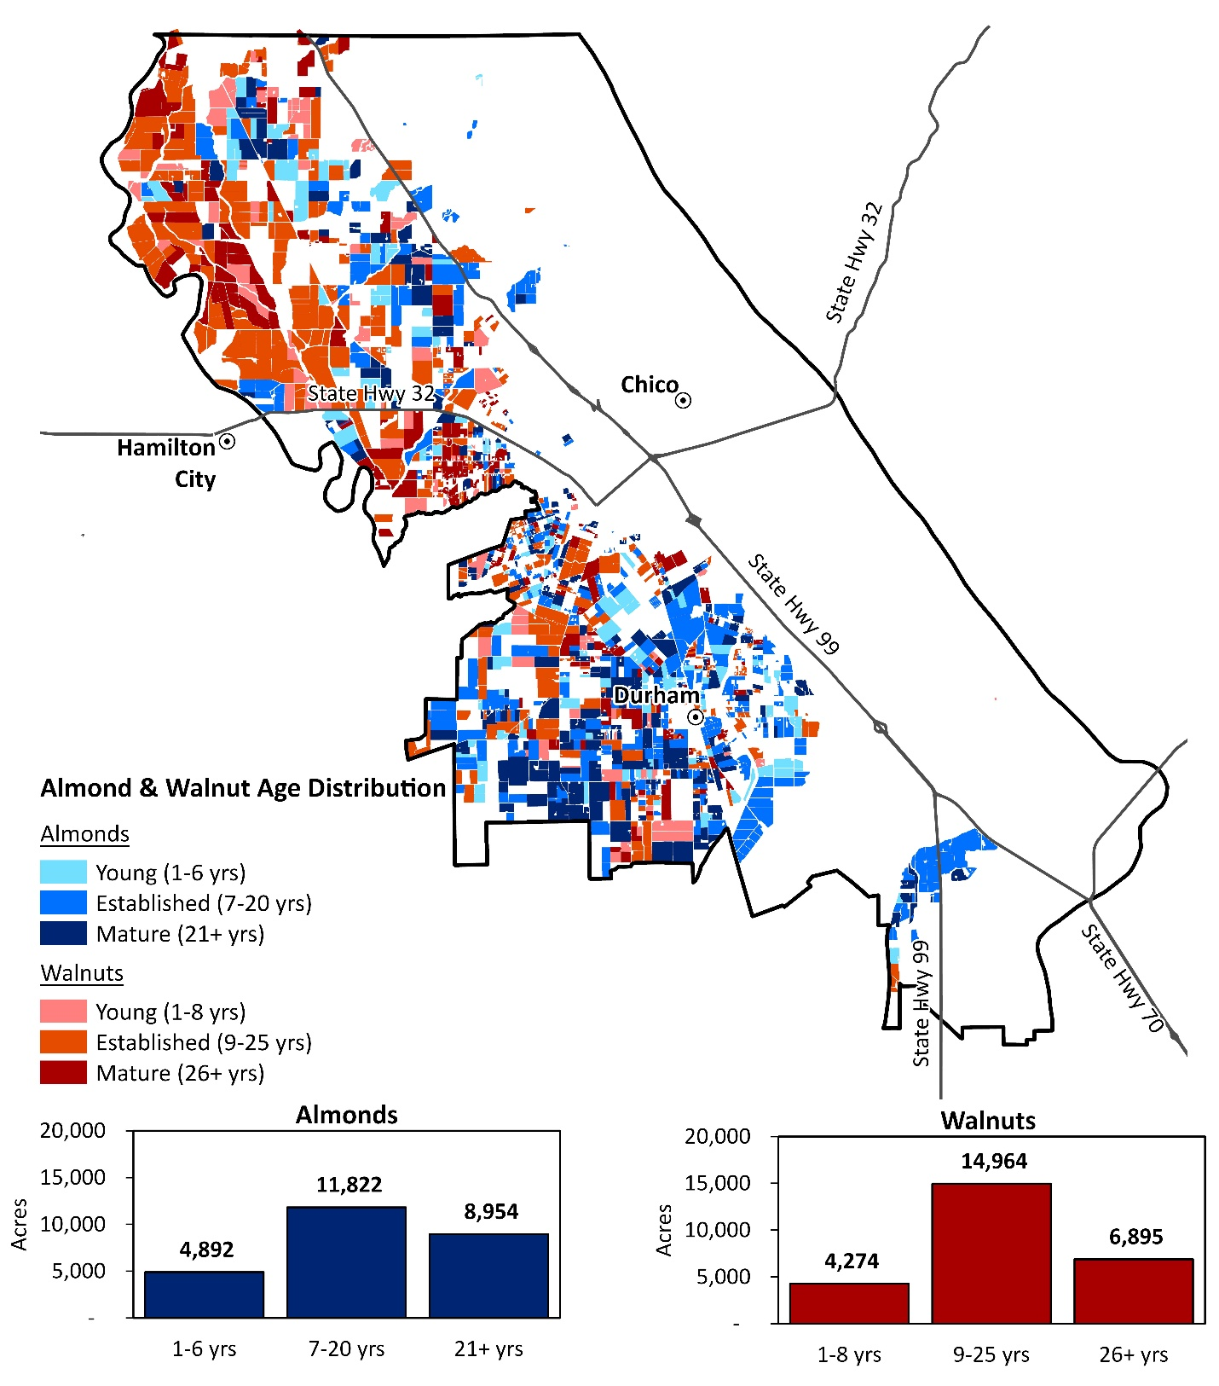
Spatial Data
Crop type and age
  Almonds: 25,668 acres (~35%)
  Walnuts: 26,133 acres (~35%)
  Other Crops/Fallow: about 20,000 acres (~30%) depending on year
    Rice
    Prunes
    Tomatoes
    Dry Beans
    Pistachios
    Grain and Hay

Slide 7
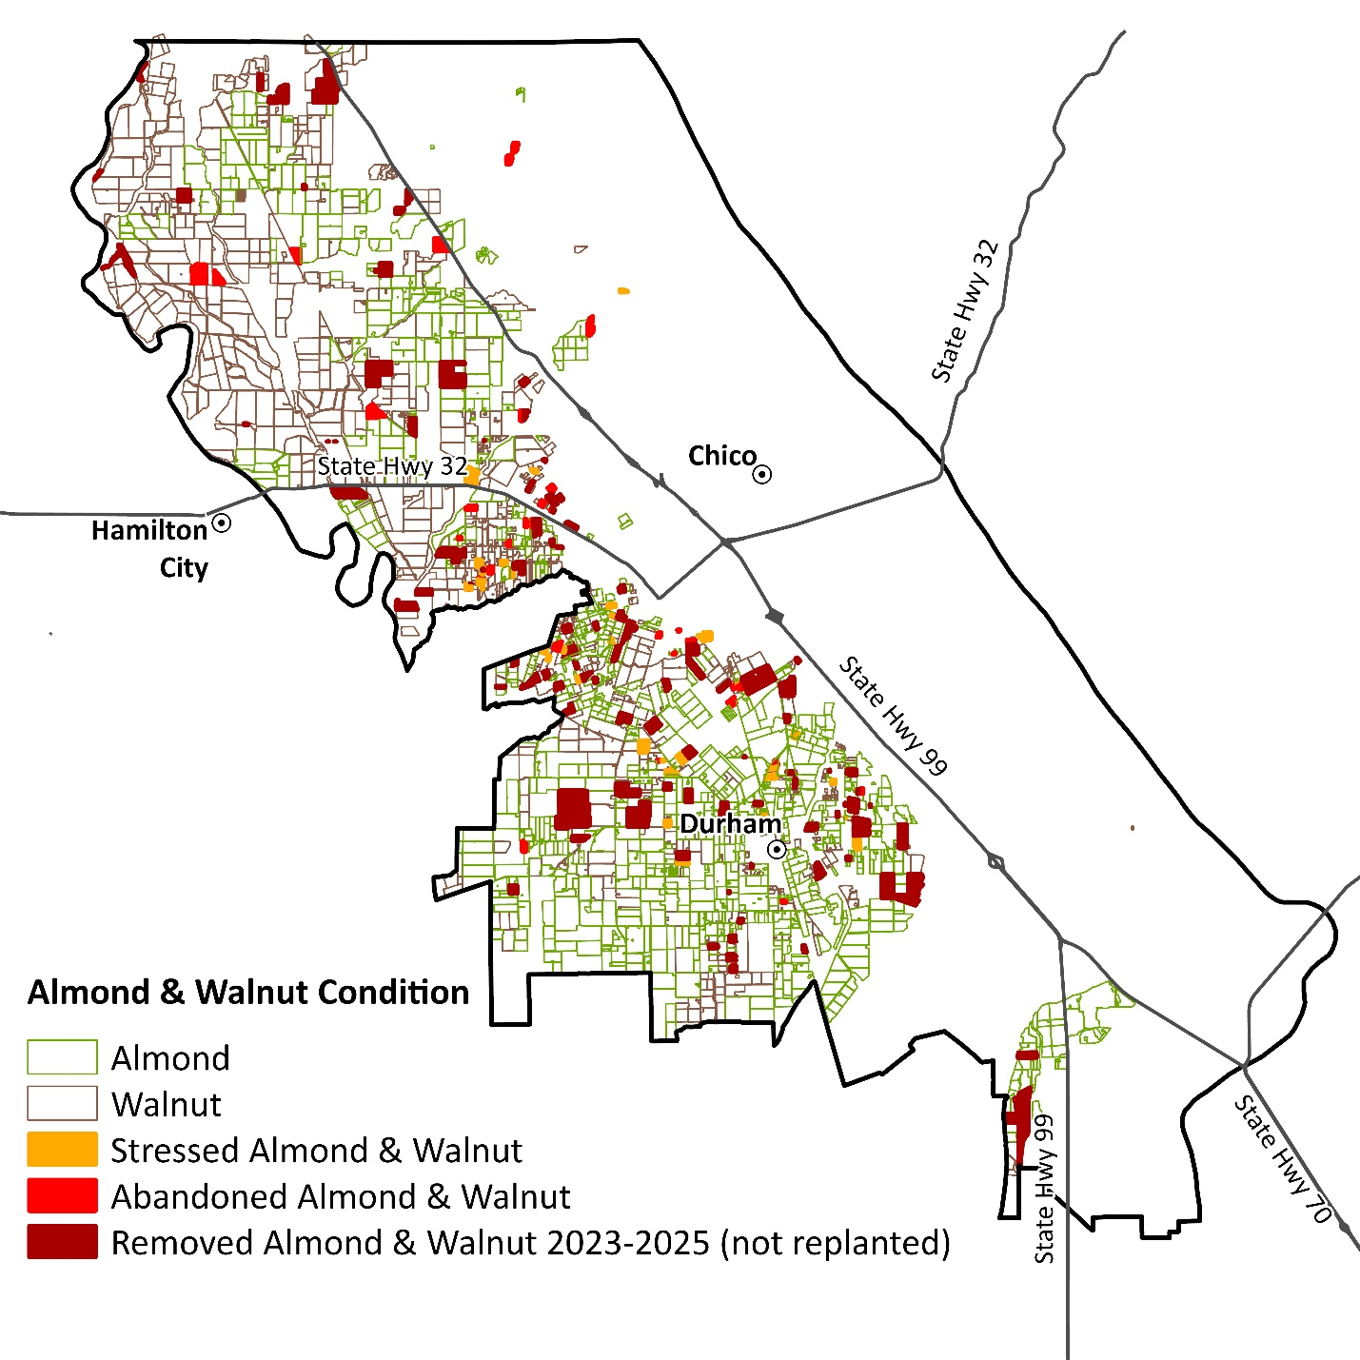
Spatial Data
Condition
  Fully Productive
  Stressed
  Abandoned
  Removed
Historical Mapping – about 10 years
  Allows for observing trends in acreage change and crop shifts
Notes:
Spatial data that helped us select pilot orchards, find orchards of similar type in the subbasin-wide analysis, and interpret results

Slide 8
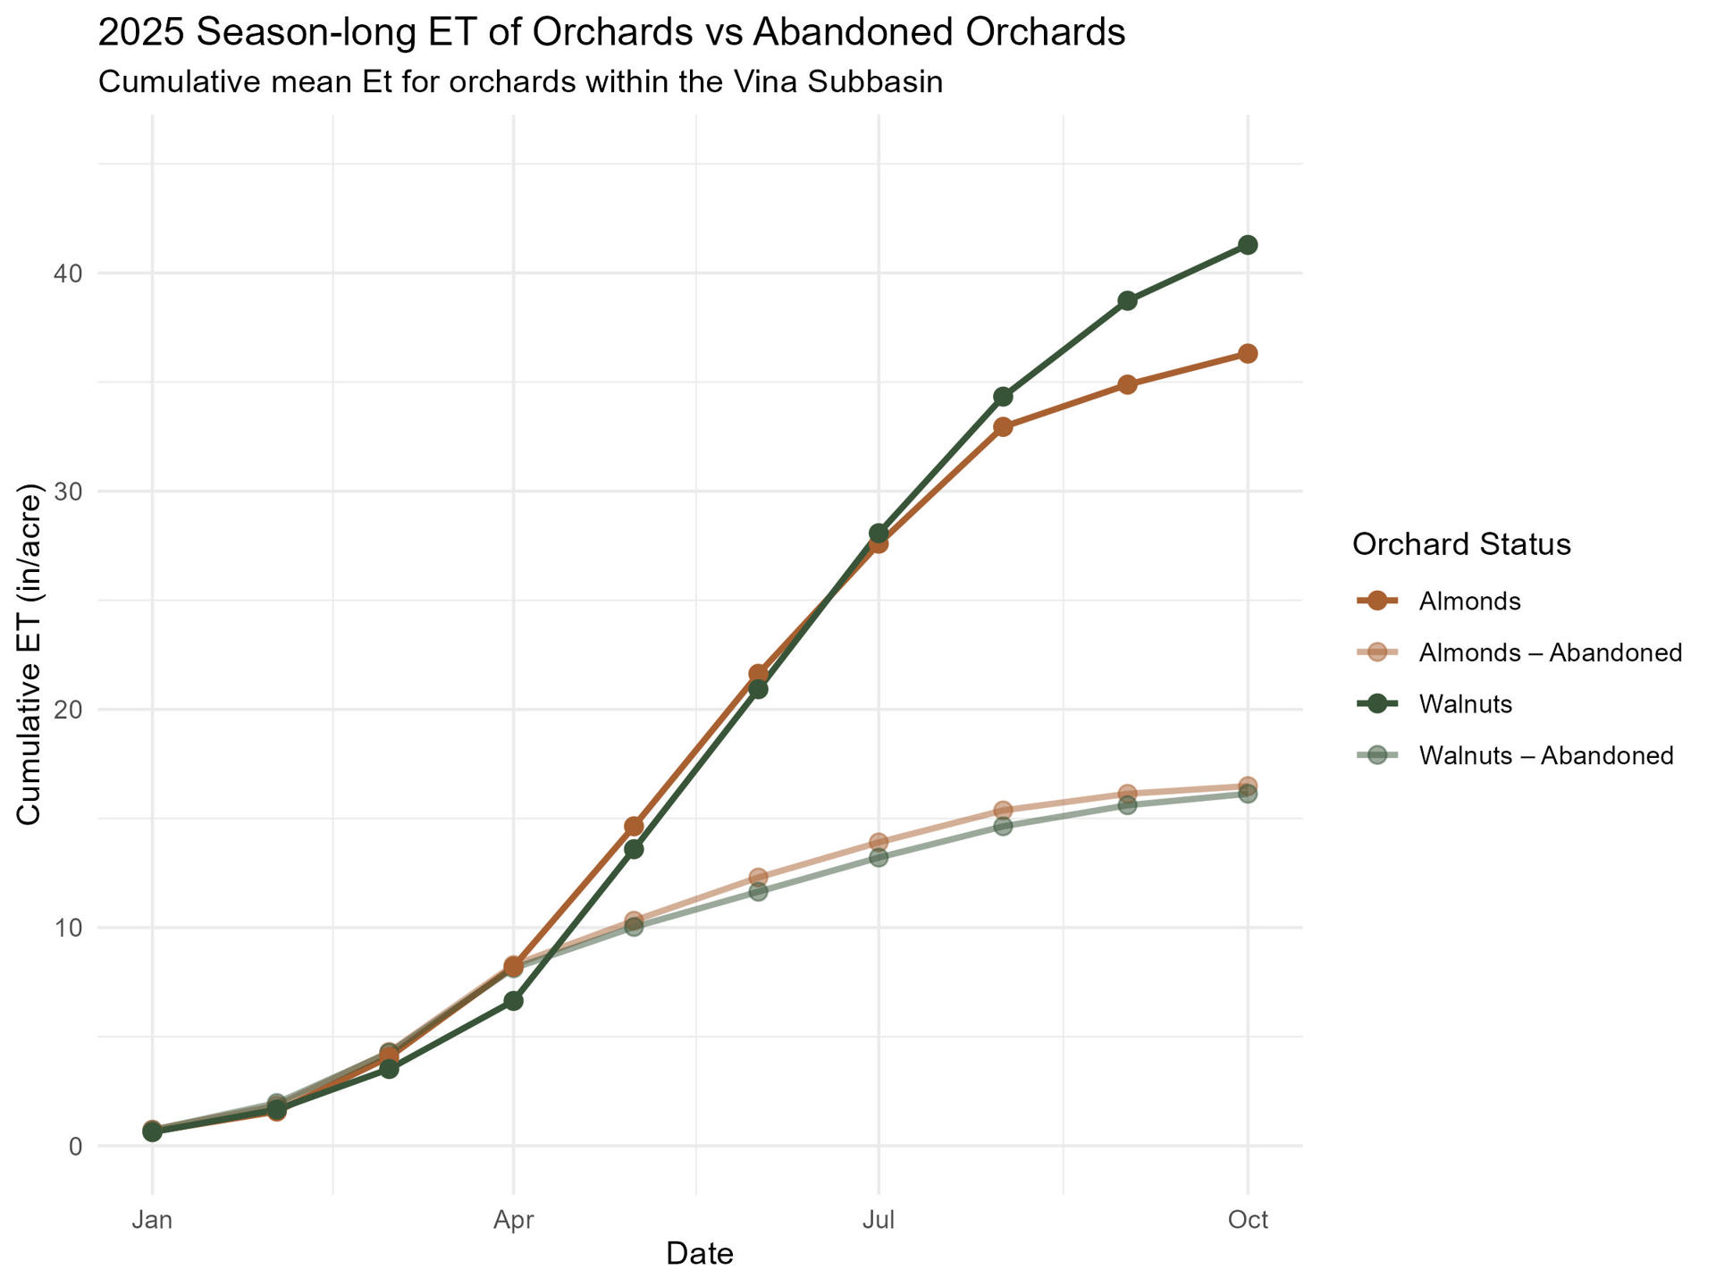
Spatial Data
Condition
  Fully Productive
  Stressed
  Abandoned
  Removed
Historical Mapping – about 10 years
  Allows for observing trends in acreage change and crop shifts
Notes:
Spatial data that helped us select pilot orchards, find orchards of similar type in the subbasin-wide analysis, and interpret results

Slide 9
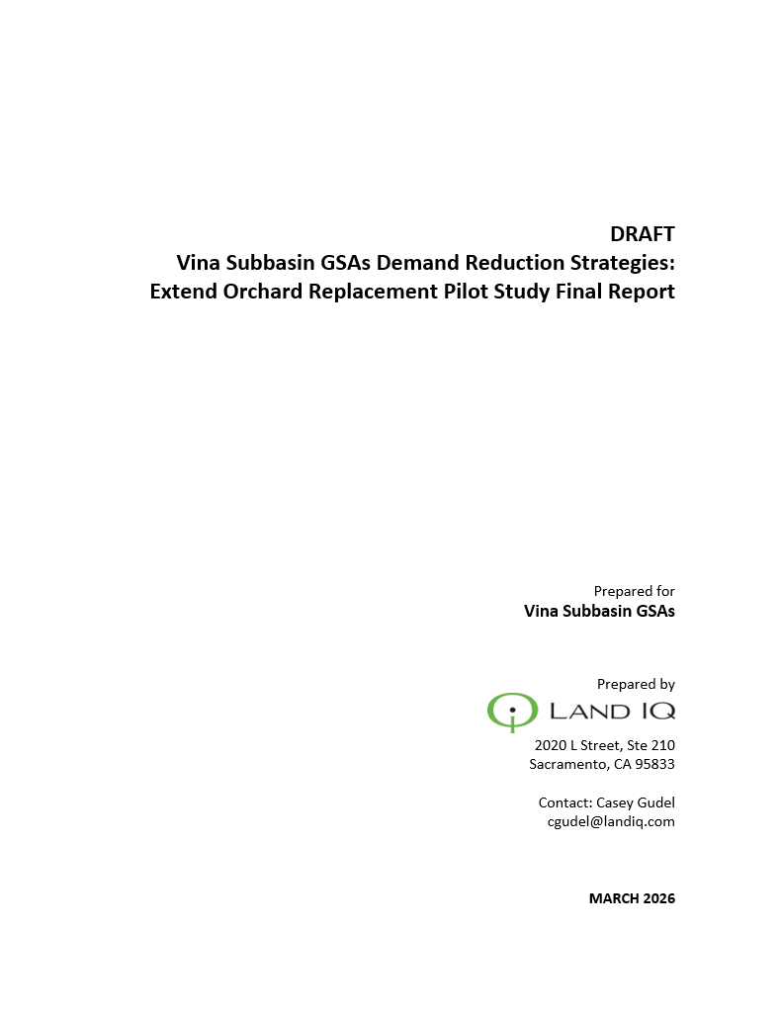
Extend Orchard Replacement:
Pilot Study Questions
What types of practices/systems (e.g. interim or cover crops) are used on idle orchard ground and how much water do they consume?
What are the costs, co-benefits and water savings of an extended orchard replacement period over the life of an orchard?
How can this knowledge be used to guide the GSA in implementing programs that realize the benefits of extend orchard replacement?

Slide 10
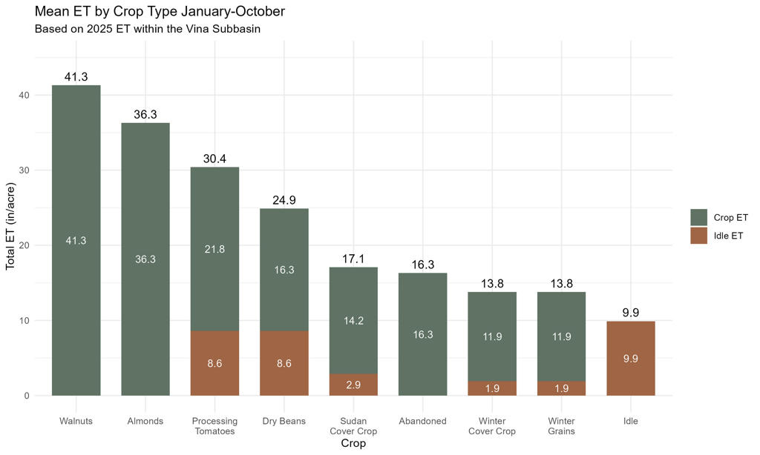
Extend Orchard Replacement:
ET Analysis By Land Use
Different crops have different consumptive use
Growing lower water use crops still saves water
Some crops rely solely on precipitation as their water source
Consumptive use of walnut and almond orchards compared to alternative land uses during the extended replant period.

Slide 11
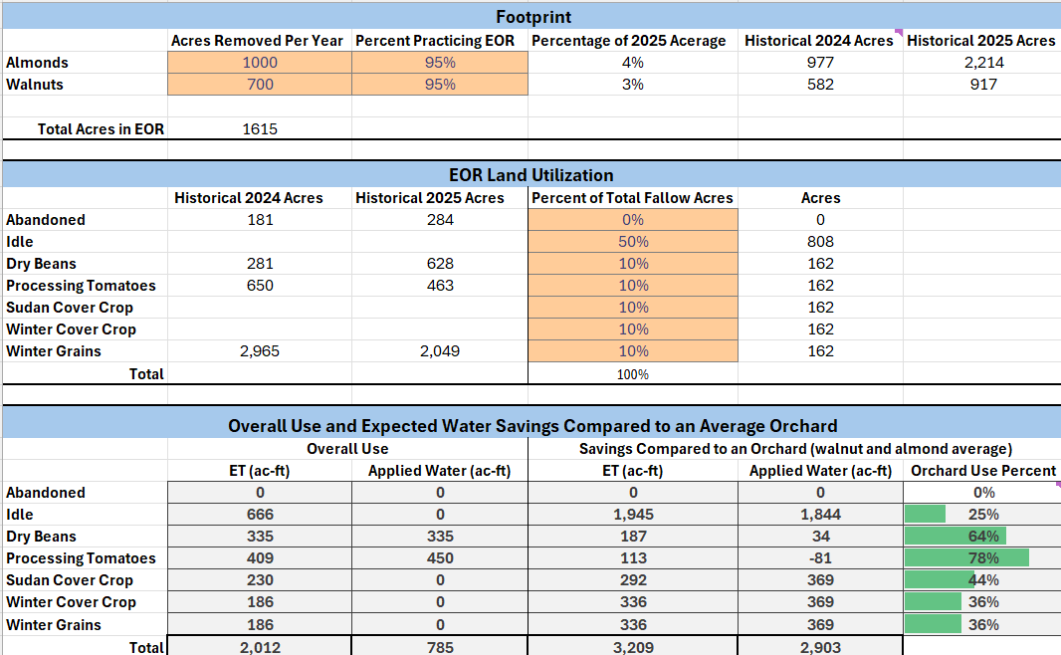
Extend Orchard Replacement:
ET Analysis By Land Use
Different crops have different consumptive use
Growing lower water use crops still saves water
Some crops rely solely on precipitation as their water source

Slide 12
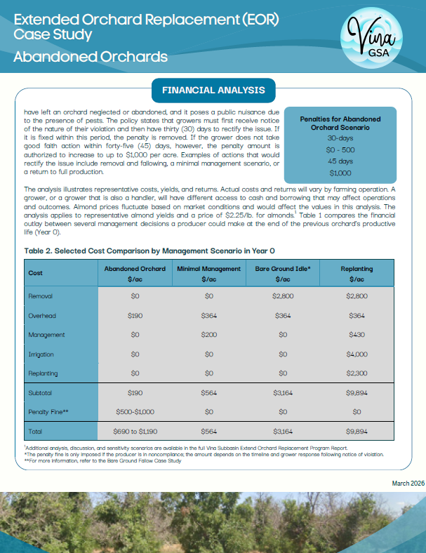
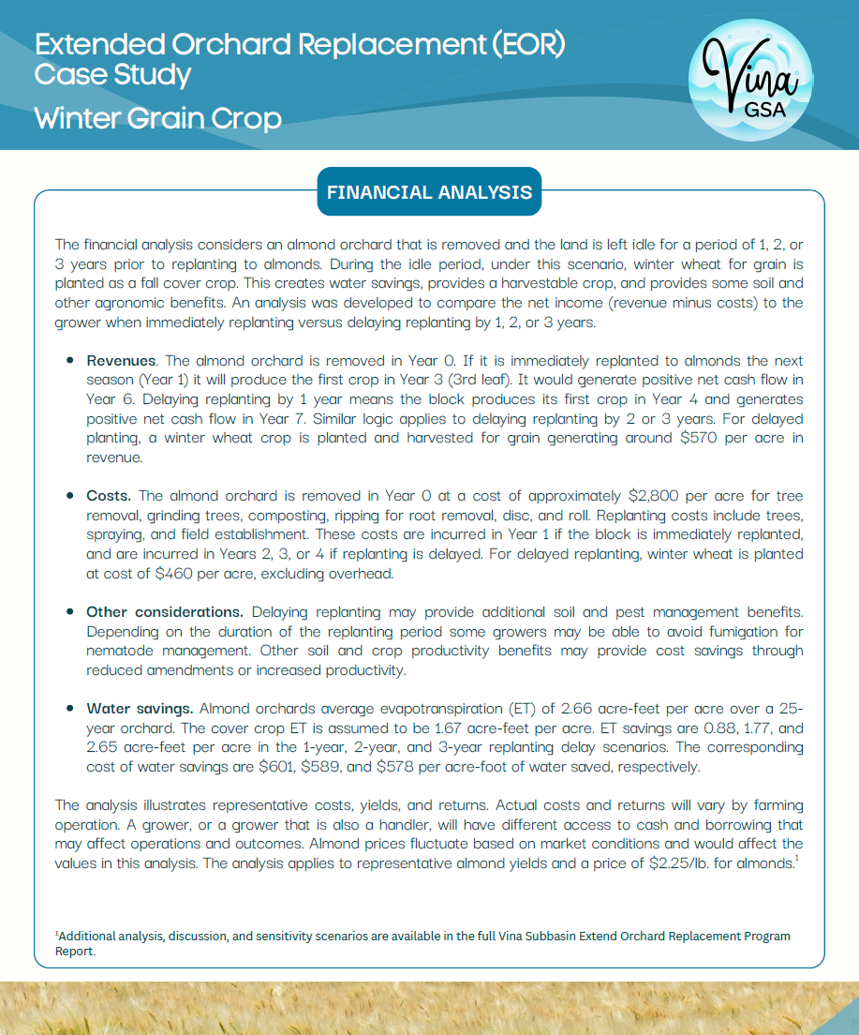
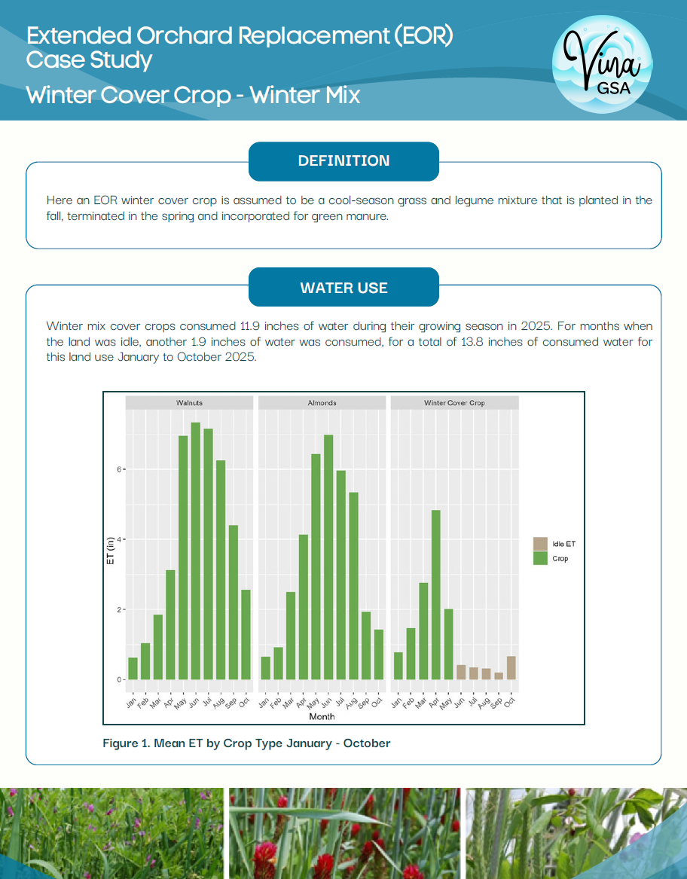
Extend Orchard Replacement:
Case Studies

Slide 13
Extend Orchard Replacement:
Key Findings
Extending the period between orchard plantings can reduce ET, resulting in measurable and significant water savings …

Slide 14
Extend Orchard Replacement:
Key Findings
Extending the period between orchard plantings can reduce ET, resulting in measurable and significant water savings …
Extended replanting incentives vary depending on how the land is used …

Slide 15
Extend Orchard Replacement:
Key Findings
Extending the period between orchard plantings can reduce ET, resulting in measurable and significant water savings …
Extended replanting incentives vary depending on how the land is used …
Harvested cover crops partially offset idling costs …

Slide 16
Extend Orchard Replacement:
Key Findings
Extending the period between orchard plantings can reduce ET, resulting in measurable and significant water savings …
Extended replanting incentives vary depending on how the land is used …
Harvested cover crops partially offset idling costs …
Short-season cash crops can substantially reduce or eliminate incentive payments …

Slide 17
Extend Orchard Replacement:
Key Findings
Extending the period between orchard plantings can reduce ET, resulting in measurable and significant water savings …
Extended replanting incentives vary depending on how the land is used …
Harvested cover crops partially offset idling costs …
Short-season cash crops can substantially reduce or eliminate incentive payments …
As an alternative to removal, some growers have been abandoning orchards …

Slide 18
Extend Orchard Replacement:
Recommendations
Update scenario budgets and incentive payments periodically …

Slide 19
Extend Orchard Replacement:
Recommendations
Update scenario budgets and incentive payments periodically …
Evaluate … the economic/financial benefits … such as soil health, amendments, water use …

Slide 20
Extend Orchard Replacement:
Recommendations
Update scenario budgets and incentive payments periodically …
Evaluate … the economic/financial benefits … such as soil health, amendments, water use …
Gather data from pilot sites and analyze the potential yield/productivity benefits …

Slide 21
Extend Orchard Replacement:
Recommendations
Update scenario budgets and incentive payments periodically …
Evaluate … the economic/financial benefits … such as soil health, amendments, water use …
Gather data from pilot sites and analyze the potential yield/productivity benefits …
Improve water use and ET estimates and apply to the cost-per-acre-foot-saved …

Slide 22
Extend Orchard Replacement:
Recommendations
Update scenario budgets and incentive payments periodically …
Evaluate … the economic/financial benefits … such as soil health, amendments, water use …
Gather data from pilot sites and analyze the potential yield/productivity benefits …
Improve water use and ET estimates and apply to the cost-per-acre-foot-saved …
Refine time of use electrical rates …

Slide 23
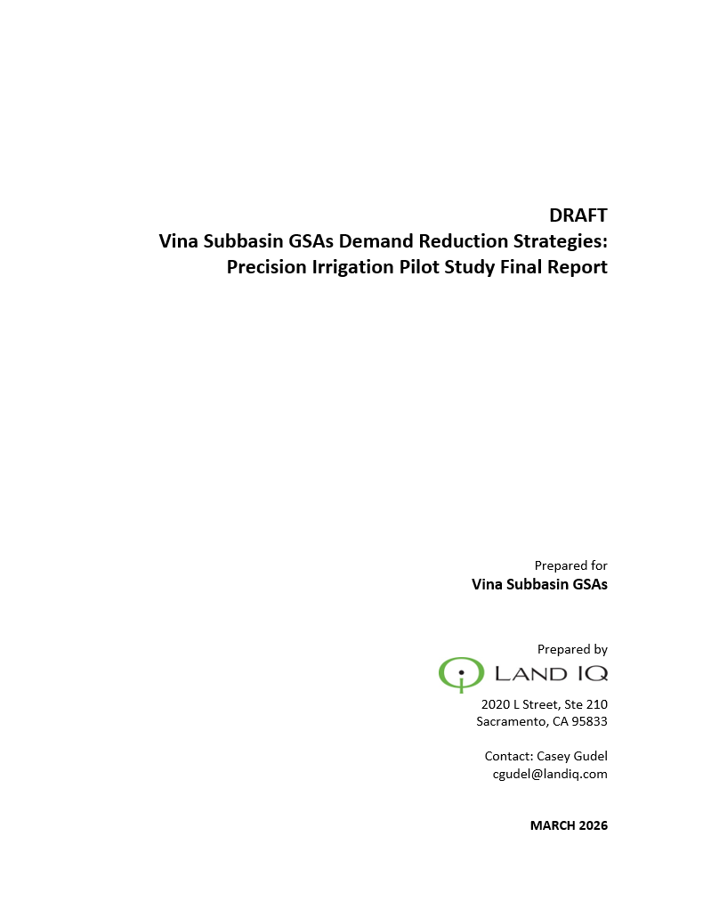
Precision Irrigation:
Pilot Study Questions
What are the irrigation scheduling approaches and technologies in use?
What is the potential for demand reduction using precision irrigation?
How can this knowledge be used to guide the GSA in implementing demand reduction programs?

Slide 24
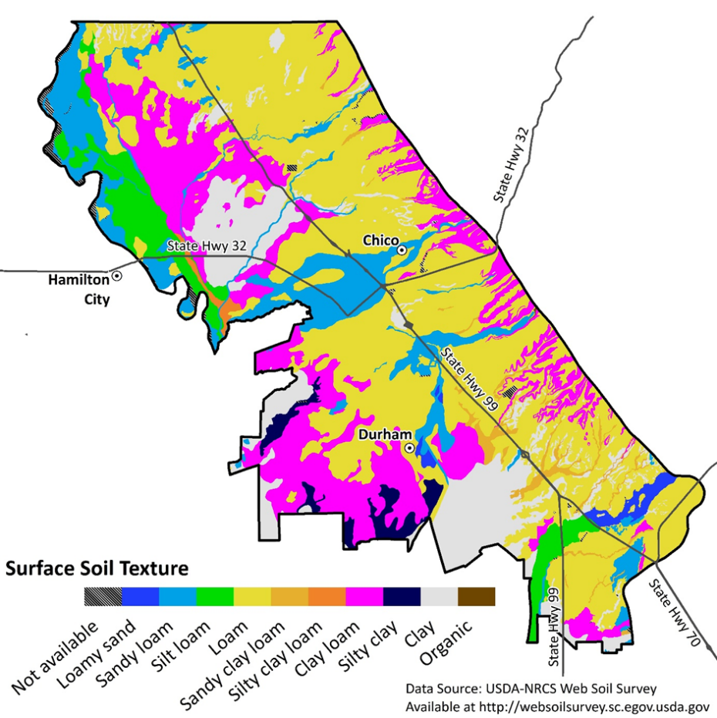
Precision Irrigation:
Analysis
Pilot orchards used for analysis
  Pruning practices
  Irrigation types
  Irrigation scheduling technologies
  ET
  NDVI
  Yield
  Applied Water
  Soil type
All orchards used to explore potential relationships between
  Crop type and age
  Irrigation methods
  ET
  NDVI
Notes:
Don’t have time to show results of all analyses

Slide 25
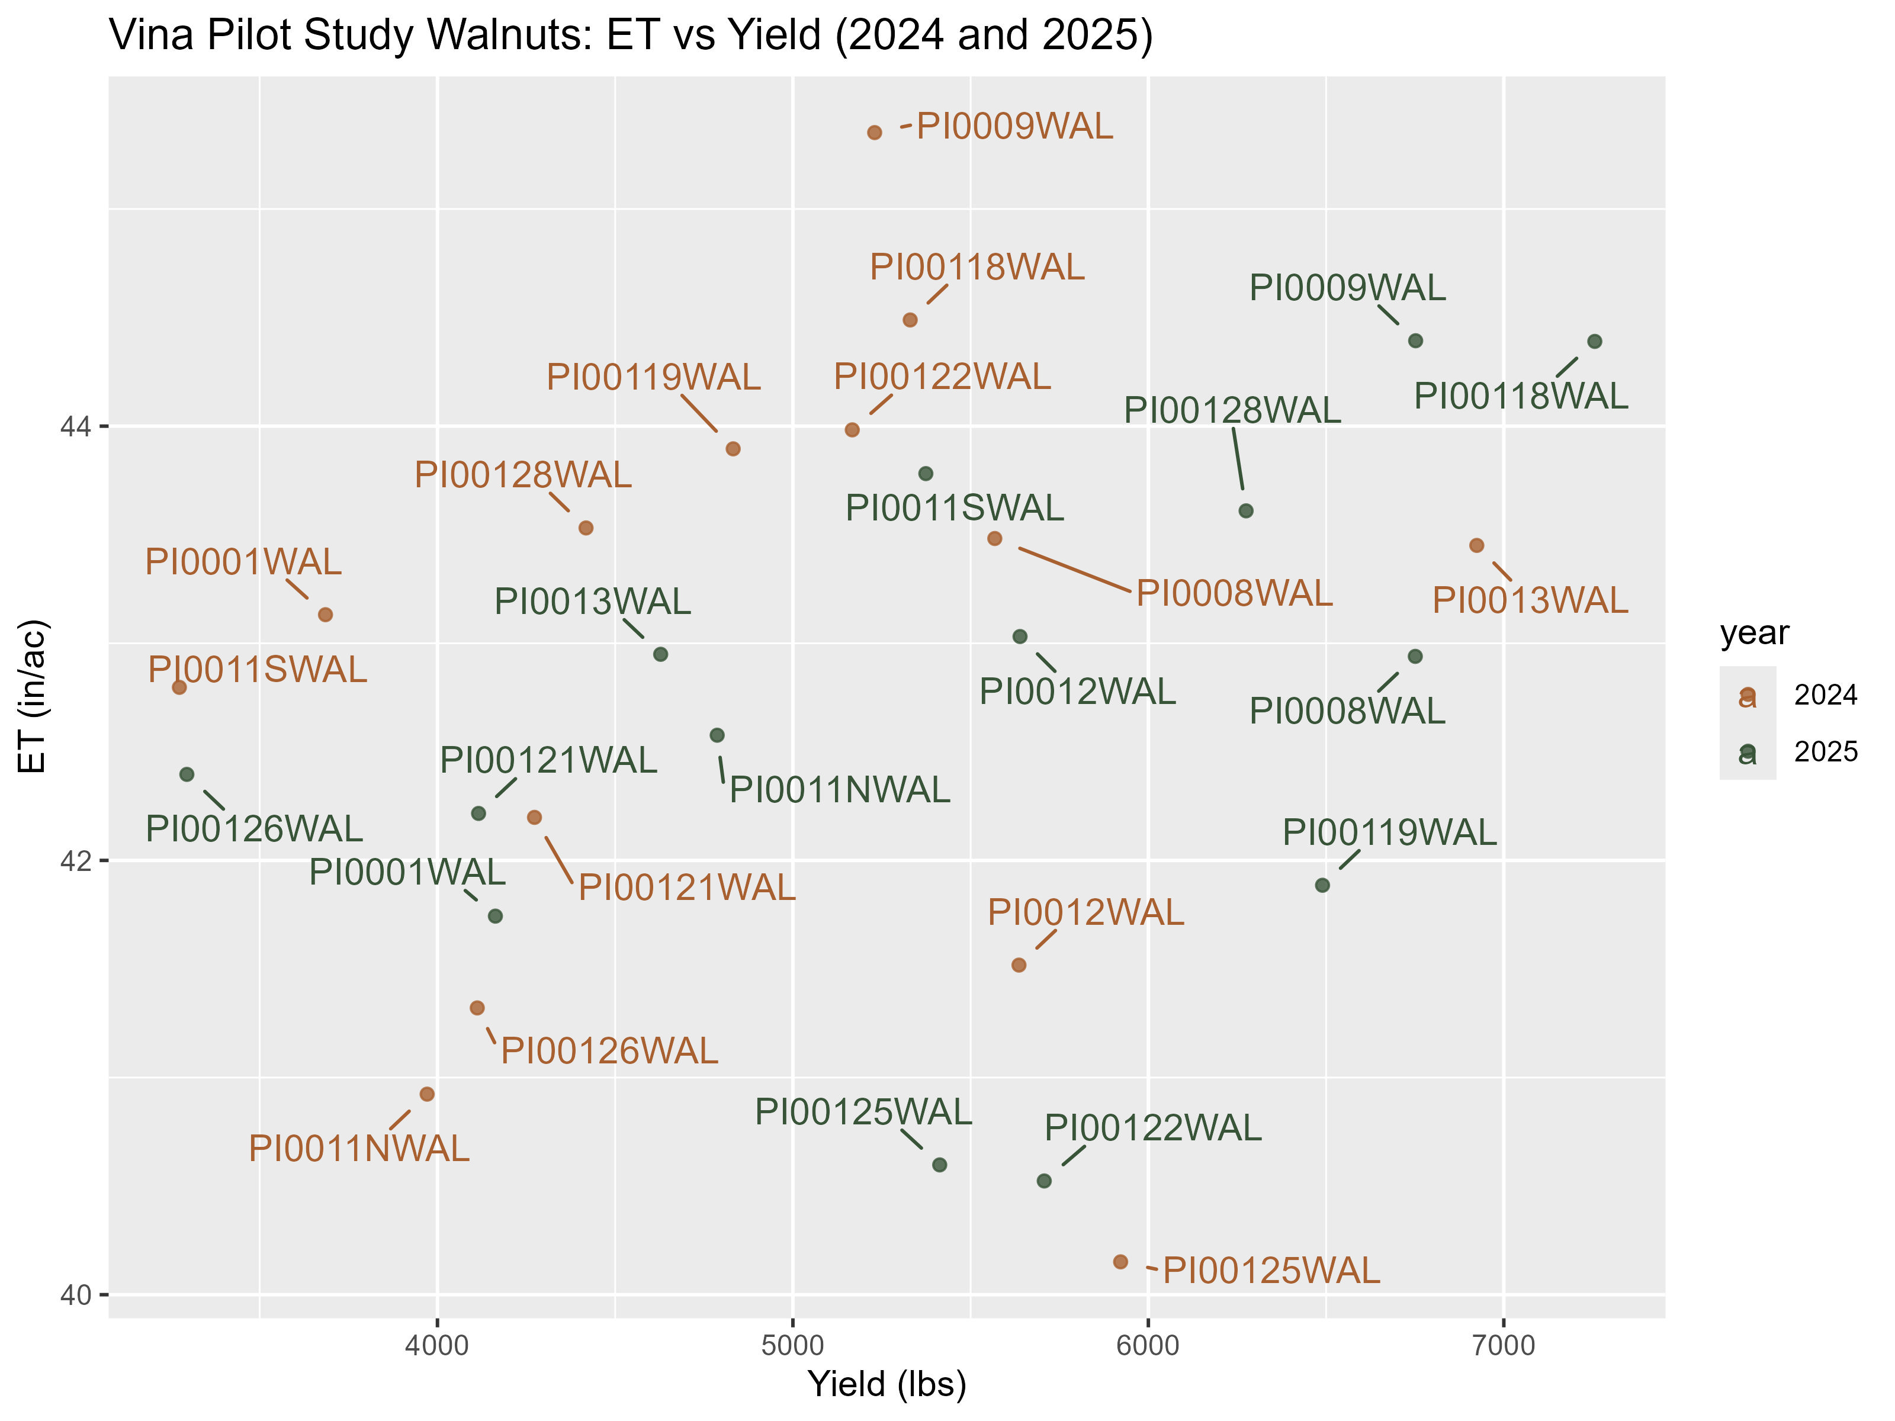
Precision Irrigation:
Analysis
Almonds & Walnuts:
  No correlation between yield and ET.
  Few, if any orchards are purposely deficit irrigated
  Yields are affected by many factors
P-value: 0.223, R²: 0.0268
Notes:
ET = January to March
2024 ET = SIMS data corrected to/calibrated by Land IQ ET
Some orchards exhibited relatively low yields but had relatively high ET. This combination is indicative of non-beneficial ET that occurs from weeds, excess canopy growth, weeds on orchard floors and/or ponded irrigation water. However, some of these same orchards had relatively high yield and low ET in the second year. Multiple years of data are needed to determine if orchards have consistent high or low productivity.

Slide 26
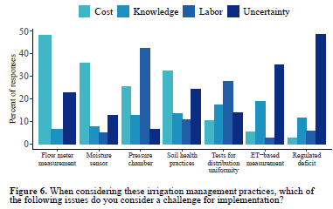
Precision Irrigation:
Analysis
Butte County Survey (2021) - these technologies are not used as much on small farms.
70% of farms are <100 ac and account for 30% of acreage.
Highest barrier to pressure chamber adoption overall is labor.
Notes:
The PI pilot study focused on medium to large sized farms using technologies to schedule irrigation and measure applied water.
The Butte County Farmer Survey (2021) indicated that these technologies were not adopted as much on small farms.
A key component for the smaller grower would be working with a consultant, which would provide information and access to technology advances that are normally only available for larger operations.
The potential to reduce groundwater demand through improving irrigation and farm practices would need to be investigated by the GSA to determine what that potential is and what the associated effort would be needed to realize it.
639 individual landowners that owned an almond or walnut orchard in the subbasin from 2019 to 2024. Of these 639 owners, 6 had more than 500 acres, 91 had 100-500 acres, 95 had 50-100 acres, and 447 had 1-50 acres.
Average orchard ET did not differ when compared between grouped small farms (5-50 ac) and grouped large farms.

Slide 27
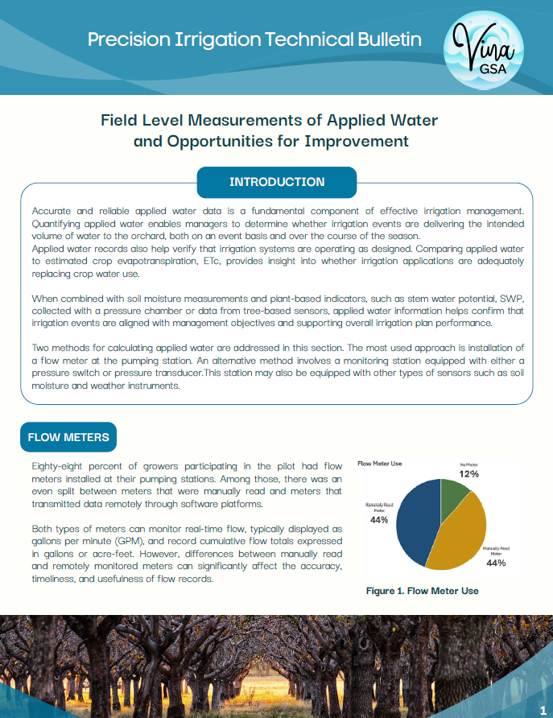
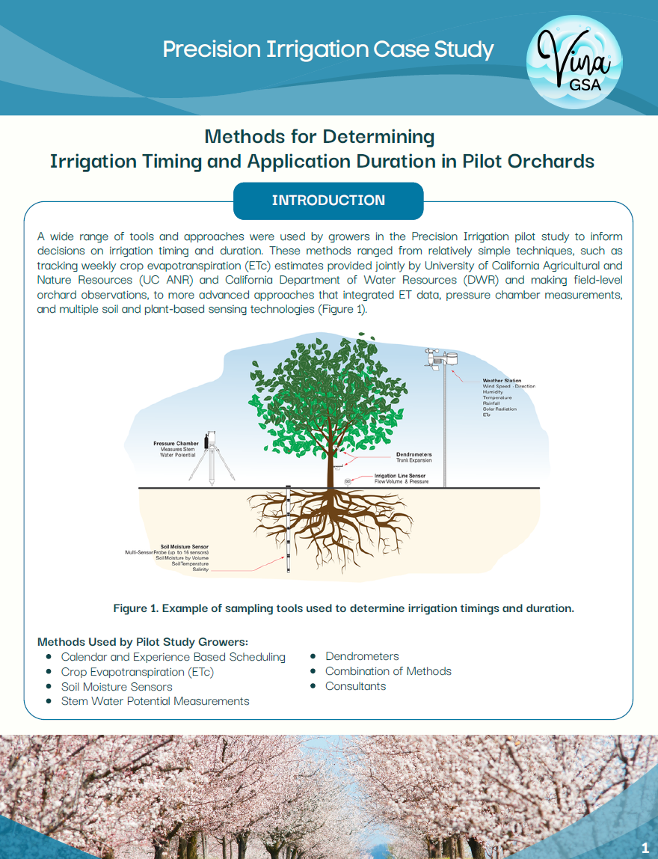
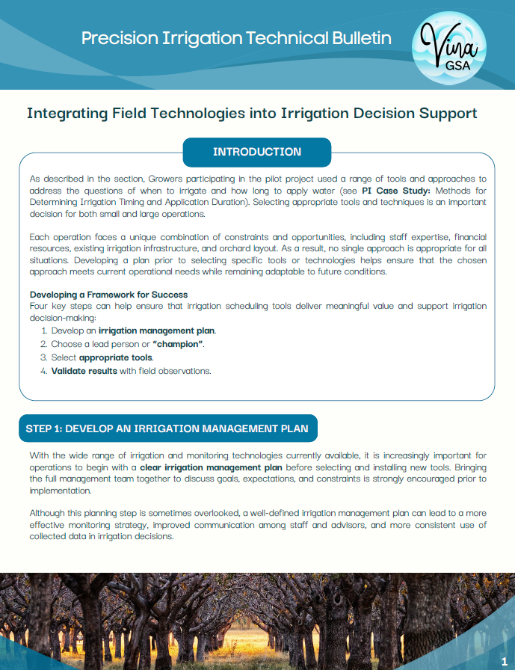
Precision Irrigation:
Technical Bulletins

Slide 28
Precision Irrigation:
Key Findings
… there were no consistent relationships between yield and consumptive water use …

Slide 29
Precision Irrigation:
Key Findings
… there were no consistent relationships between yield and consumptive water use …
For most medium and large farms, there is little evidence for substantial opportunity to reduce ET …

Slide 30
Precision Irrigation:
Key Findings
… there were no consistent relationships between yield and consumptive water use …
For most medium and large farms, there is little evidence for substantial opportunity to reduce ET …
Irrigation system management was more important that irrigation type in maximizing water use …

Slide 31
Precision Irrigation:
Key Findings
… there were no consistent relationships between yield and consumptive water use …
For most medium and large farms, there is little evidence for substantial opportunity to reduce ET …
Irrigation system management was more important that irrigation type in maximizing water use …
Walnuts appeared to respond to less irrigation while improving production … not the same in almonds

Slide 32
Precision Irrigation:
Key Findings
… there were no consistent relationships between yield and consumptive water use …
For most medium and large farms, there is little evidence for substantial opportunity to reduce ET …
Irrigation system management was more important that irrigation type in maximizing water use …
Walnuts appeared to respond to less irrigation while improving production … not the same in almonds
… more potential for improved water management … on small farms

Slide 33
Precision Irrigation:
Key Findings
… there were no consistent relationships between yield and consumptive water use …
For most medium and large farms, there is little evidence for substantial opportunity to reduce ET …
Irrigation system management was more important that irrigation type in maximizing water use …
Walnuts appeared to respond to less irrigation while improving production … not the same in almonds
… more potential for improved water management … on small farms
… potential to reduce the evaporation portion of ET by using more nighttime irrigation

Slide 34
Precision Irrigation:
Recommendations
… identification of non-beneficial ET … would need multiple years of yield and ET data …

Slide 35
Precision Irrigation:
Recommendations
… identification of non-beneficial ET … would need multiple years of yield and ET data …
… The Vina GSA should investigation the potential to improve irrigation management with advanced technologies on small farms

Slide 36
Precision Irrigation:
Recommendations
… identification of non-beneficial ET … would need multiple years of yield and ET data …
… The Vina GSA should investigation the potential to improve irrigation management with advanced technologies on small farms
… focus efforts related to specific irrigation management practices on the use of pressure chambers … particularly in walnut production

Slide 37
Precision Irrigation:
Recommendations
… identification of non-beneficial ET … would need multiple years of yield and ET data …
… The Vina GSA should investigation the potential to improve irrigation management with advanced technologies on small farms
… focus efforts related to specific irrigation management practices on the use of pressure chambers … particularly in walnut production
… education and outreach would be needed on the associated financial savings of automation and nighttime irrigation

Slide 38
Demand Reduction Strategies
Extend Orchard Replacement (EOR) Pilot Study
Precision Irrigation (PI) Pilot Study
Vina GSA Board of Directors – March 11, 2026
Joel Kimmelshue, PhD, Land IQ

